Slide 1
Prepared by Aurora Team (Group – 4)
EWSD Group Project
Aurora University Magazine
Date : 10 May, 2025
. . . . .

Slide 2
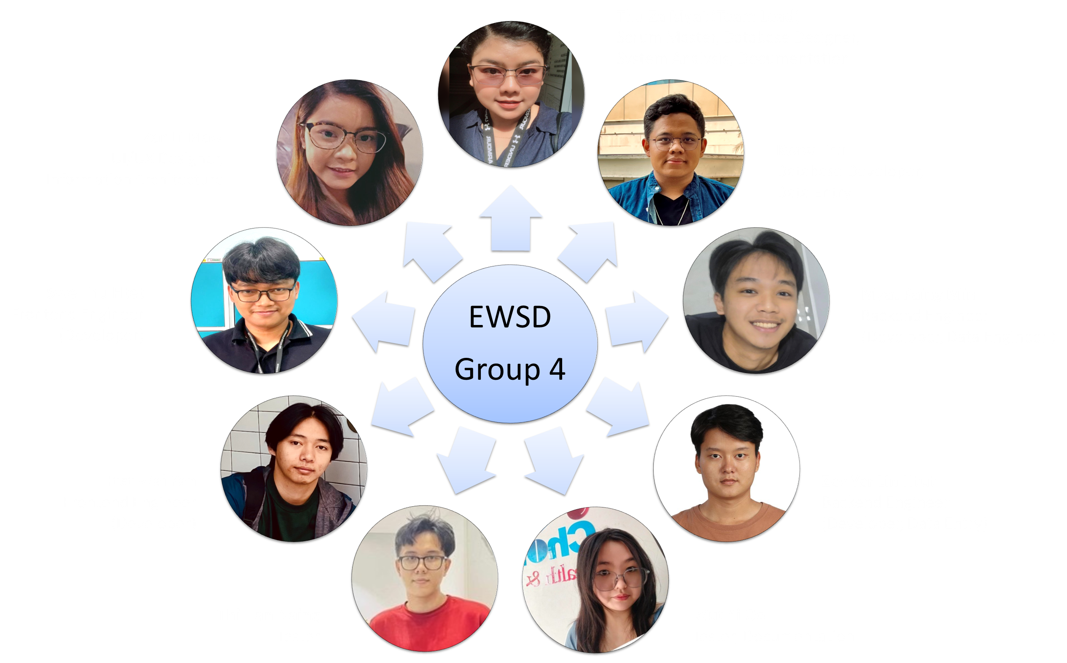
Our Project Team

Slide 3
Duty and Responsibility
No | Name | Duty and Responsibility
1 | Thu Za Myat (Team Lead) | Served as the Scrum Master, Database Designer (Logical), and led our System Analysis, Screen Cast, program tester for specification and finalize documentation tasks.
2 | Zar Li Maw | UI/UX Designer and Information Architect.She designed the system layout and ensured the best user experience. Documentation for Meeting Minutes.
3 | Swe Thu Htet | Frontend Engineer (Developer) : Group Lead He worked on developing the system's user interface and functionality.
4 | Htet Wai Yan | Frontend Engineer (Developer) and Tester (frontend) He also focused on building a seamless frontend experience
5 | Kyaw Thu | Database Developer (Physical) and Data Entry He managed database development and data entry tasks.
6 | Myat Paing Min | Backend Engineer (Developer) : Group Lead He worked on backend development and data engineering to ensure system performance.
7 | Zay Yar Lin Htut | Backend Engineer (Developer) and Tester (frontend) He contributed to backend development and database integration.
8 | Thi Han Naing | Tester : Group Lead He focused on prepare test log. Finding bugs and ensuring system quality.
9 | Wut Yi Oo | Tester (support) and Documentation (Lead) She worked on system testing, prepare test log and Lead format and finalize documentation

Slide 4

Topics
System Introduction & Future Developments
Documentation
Prgram Design & Frontend Developments
Testing
Database & Backend Developments
Program Runtime (Demo)
. . . . .

Slide 5
Project Overview and Key Feature
Project Overview:
Key Feature :
Our project focuses on providing
a secure,role-based system for managing student article submissions
reviews, and publications for the university magazine.
Using this platform, different users can contribute, review, and manage magazine content efficiently as
Admins
Marketing Managers
Marketing Coordinators
Student
Guest
The system includes key features such as:
Secure role-based login /
Article submission, editing, and publication
Role-specific dashboards and notifications
Feedback and approval workflows
User management and reporting tools
We designed the system with a focus on security, usability, and efficiency

Slide 6

System Introduction
Developed a secure, role-based web system for managing student submissions to the AURORA University annual magazine.
Supports six faculties: Science, Mathematics, Art, Engineering, IT, and Business.
Ensures data protection by assigning roles: Admin, Student, Guest, Marketing Coordinator, Marketing Manager.
Built using Agile SCRUM methodology with clear team roles and collaboration.
Focuses on a user-friendly design to ensure smooth, secure, and efficient article submission and management.
. . . . .

Slide 7
Feature (Extended Future Development)
Enhanced User Experience • Download “Article of the Year” as polished PDFs • Reading history tracker for effortless revisits • Improved multilingual support (buttons, forms, articles)
Business Concept Features • Premium subscription for best-selling author articles • Guest user access for special events • Research library with excellent student papers
Community Engagement • Follow favorite authors • Post comments on author profiles
Accessibility Enhancements • Keyboard navigation • Screen reader support • Resizable text for better usability

Slide 8
Site Map

Slide 9
Methodology, Technologies Used, Challenges and Solutions
Mehodology: We followed Agile Scrum methodology to develop the system in sprints.
We held regular meetings, sprint plannings, daily standups, and sprint reviews to ensure continuous improvement throughout the project.
Technologies: We using different technologies and different platform as follows;
UI/UX Design : Figma, Canva
Frontend : HTML, CSS, JavaScript
Backend : PHP
Database : MySQL
Hosting : Vercel for frontend, database hosted separately on MySQL Workbench
Tools : GitHub for version control, Trello for task management, Draw IO for diagrams, Microsoft Project for Gantt Chart & Project Control, Microsoft office (Word, Excel, Powerpoint)
Challenges & : Integrating secure login across different user roles,Managing real-time article submission
status, Maintaining system performance under multiple access points.
Solutions : We overcame these challenges through strong team collaboration, encourage to each other,
regular testing, team reinforcement and research.

Slide 10
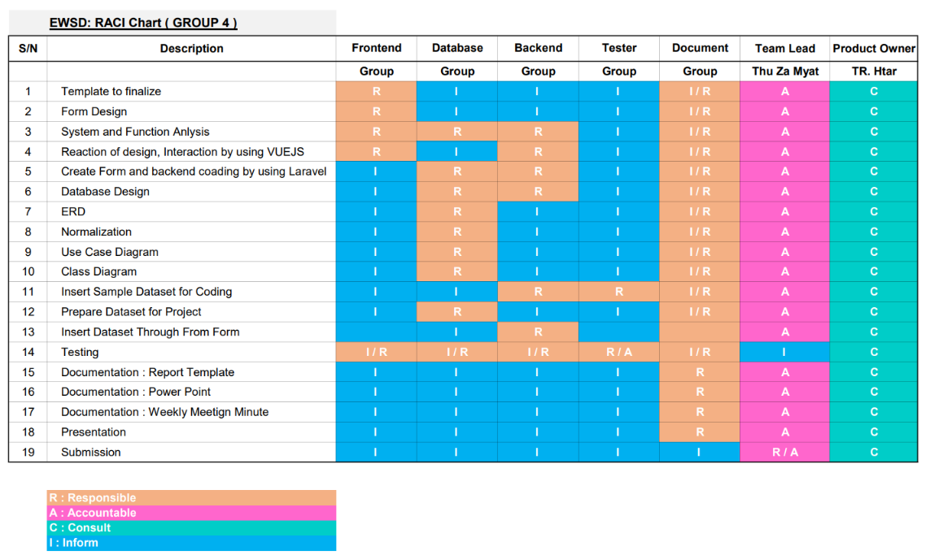
Planning : RACI CHART
RACI is the model that quick way to lay out roles and duties on the project.
If the project is slow down or any barrier, easy to trace back which area require for reinforcement.
Our team use for RACI chart to assign duties and roles before starting the project.

Slide 11
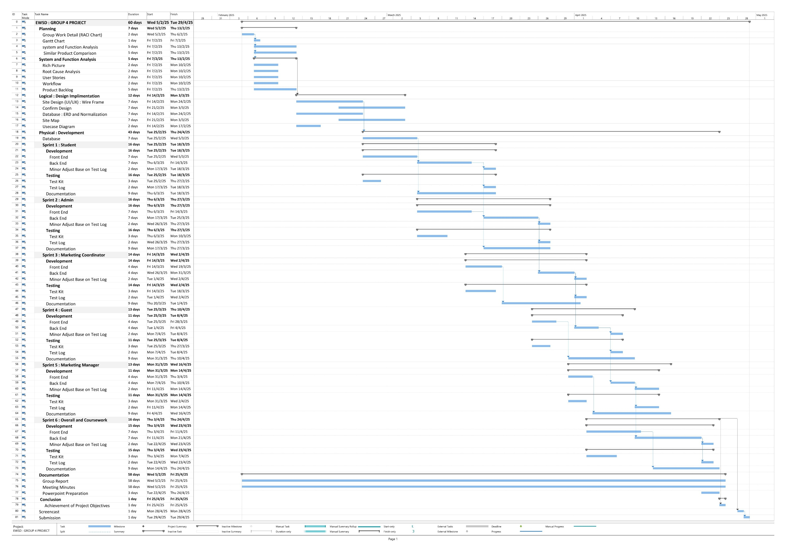
Planning : Gantt Chart
Total Duration :
60 days

Slide 12
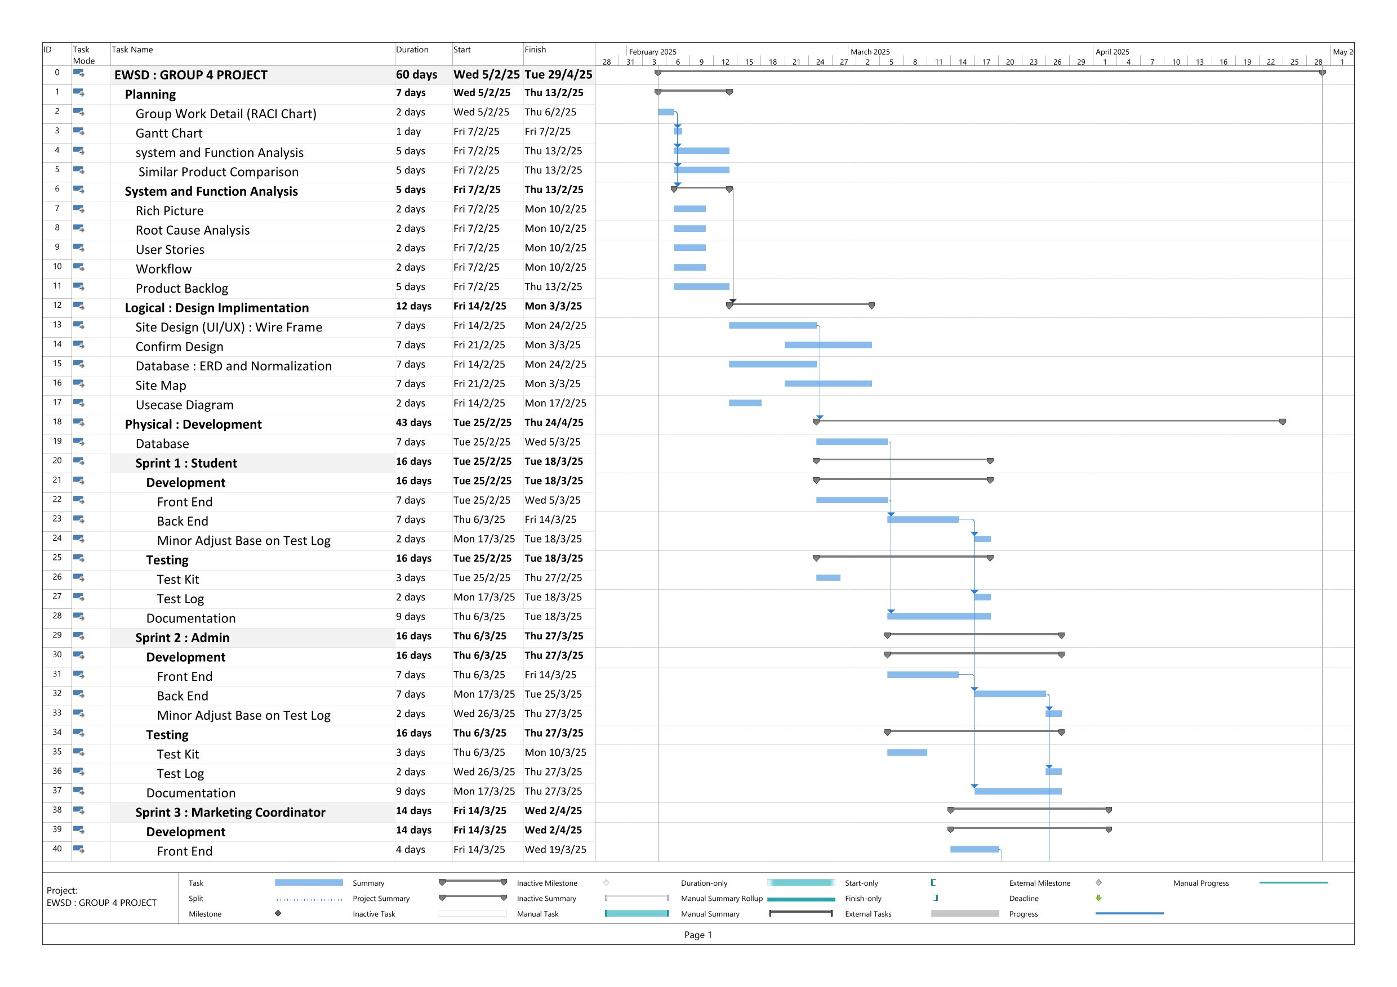
Planning : Gantt Chart

Slide 13
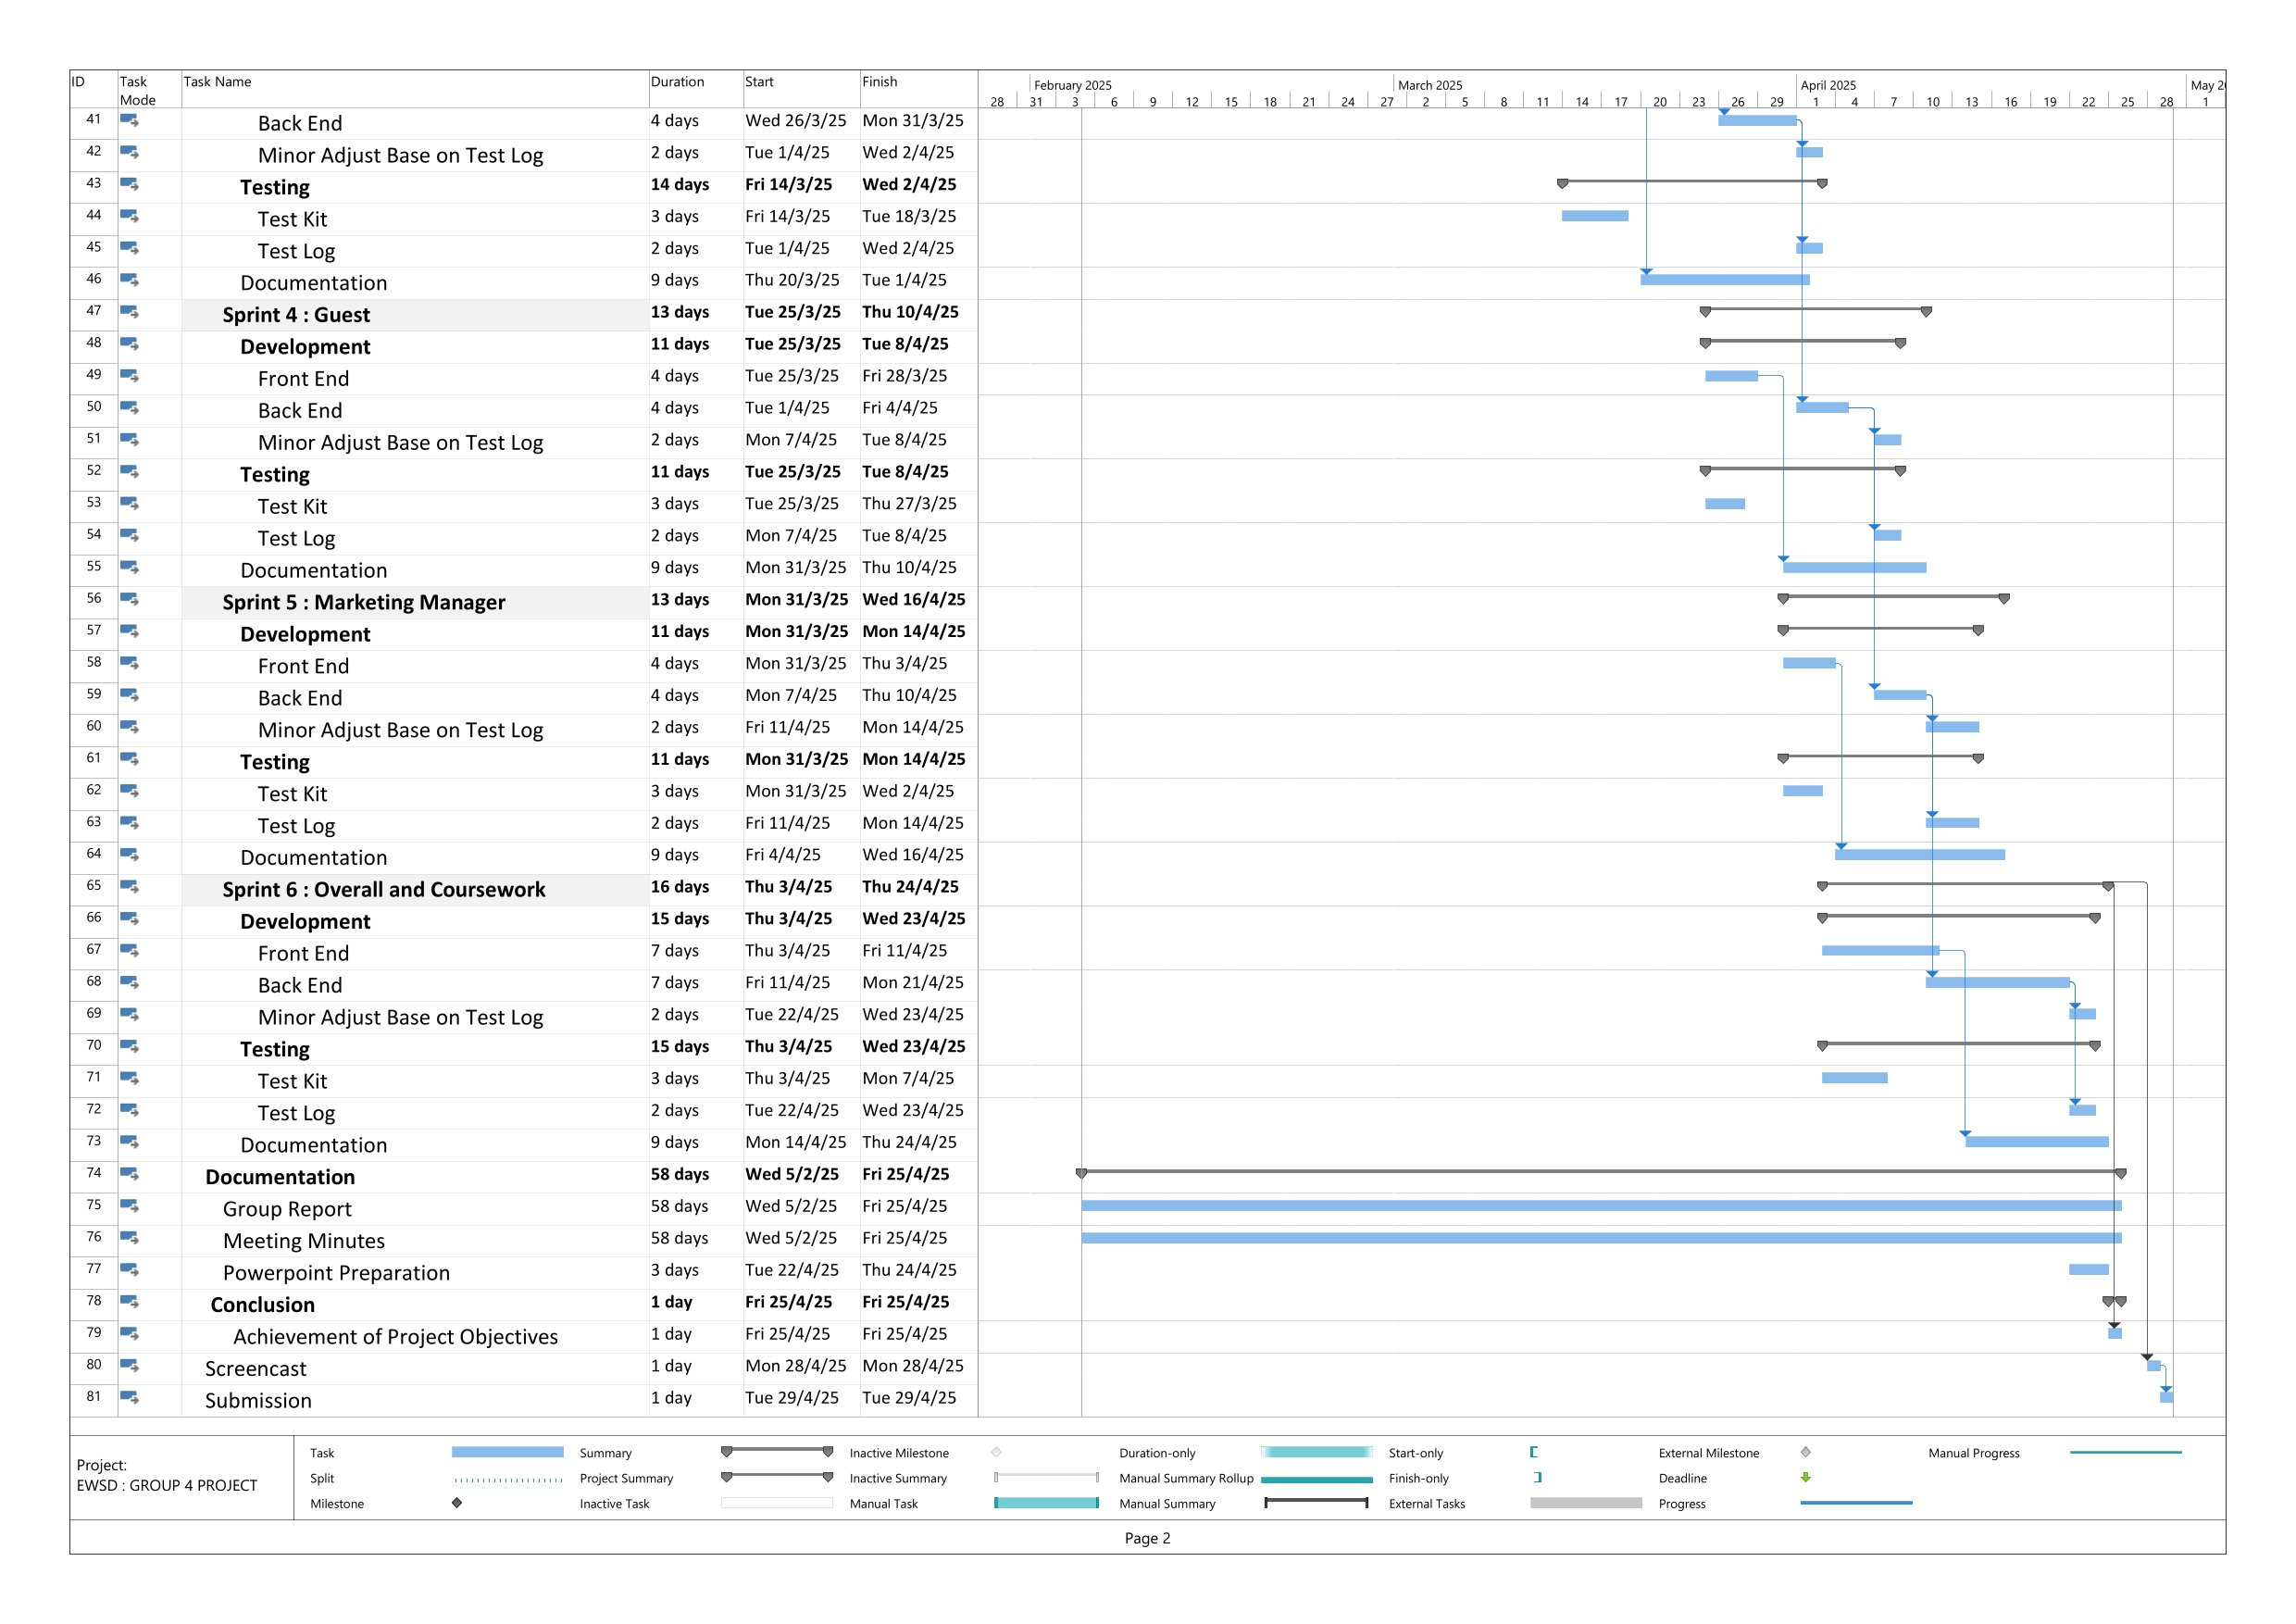
Planning : Gantt Chart

Slide 14

Product Backlog & Sprint Planning
Product Backlog:
The Product Backlog was created at the start of the project to prioritize tasks and guide the development process.
It listed essential features and improvements, helping the team stay organized and efficient.
Items were arranged by importance, ensuring the most critical functions were addressed first.
Sprints:
The backlog was divided into smaller, time-boxed development cycles called Sprints.
Each Sprint focused on delivering specific, working features for the system.
This allowed the team to adapt to feedback, improve quality, and ensure steady progress.

Slide 15
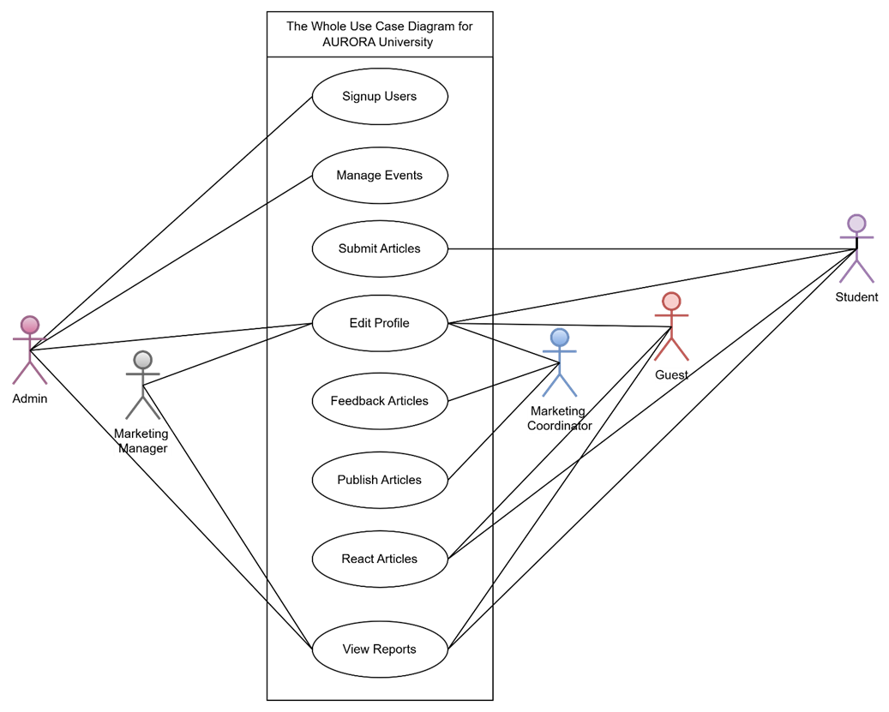
Usecase Diagram
The summarize user detail in the system with their interaction with the system is the use case diagram. Such as the diagram of user and their roles of function in the system.
. . . . .

Slide 16
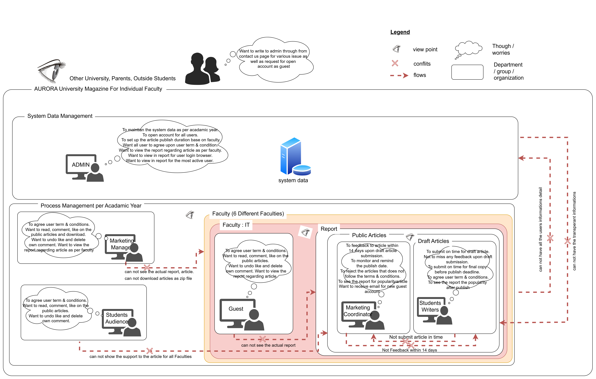
Analysis : Rich Picture
Rich Picture : A virtualize approach for the various related part of the problem in current situation.
Root Cause Analysis : Root cause are the source of the problem that facing the organization but they are hidden.

Slide 17
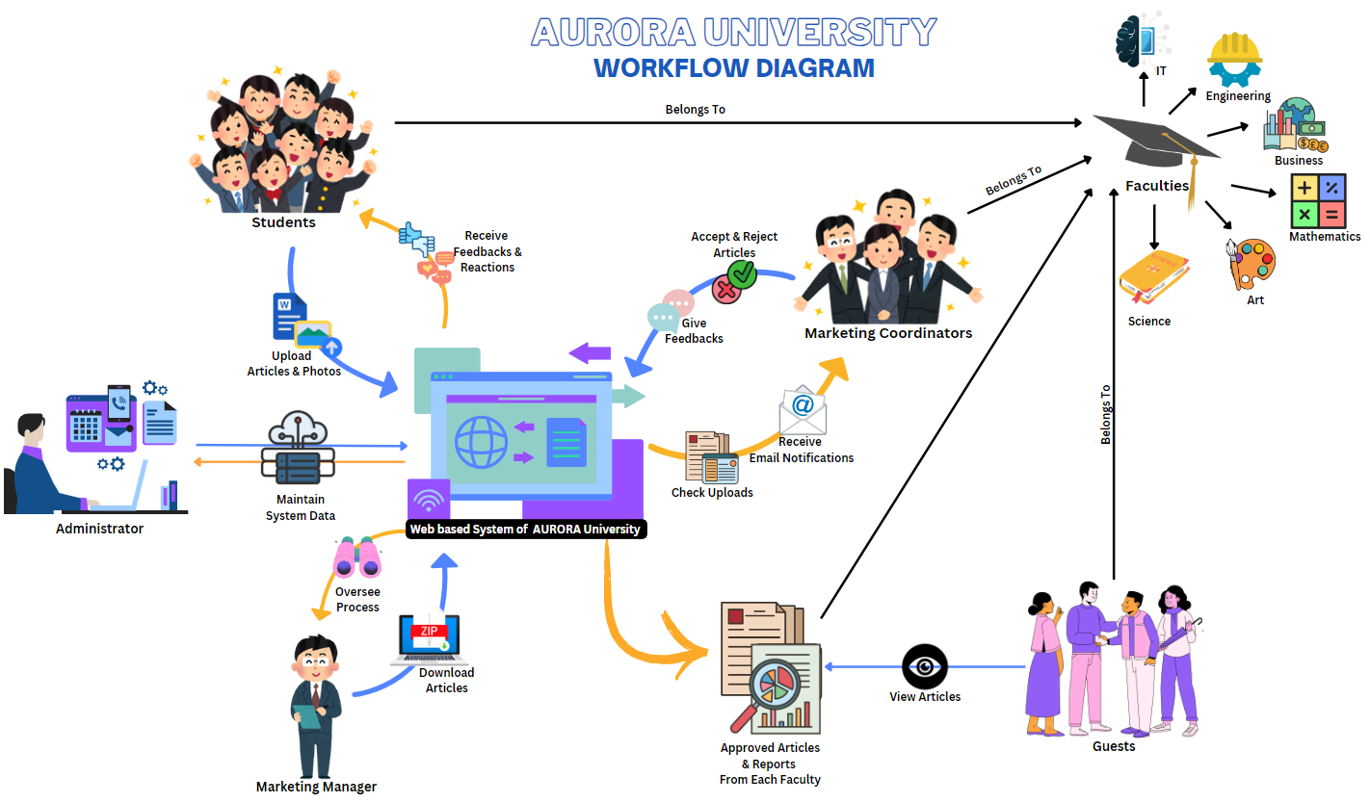
Workflow Diagram
. . . . .

Slide 18
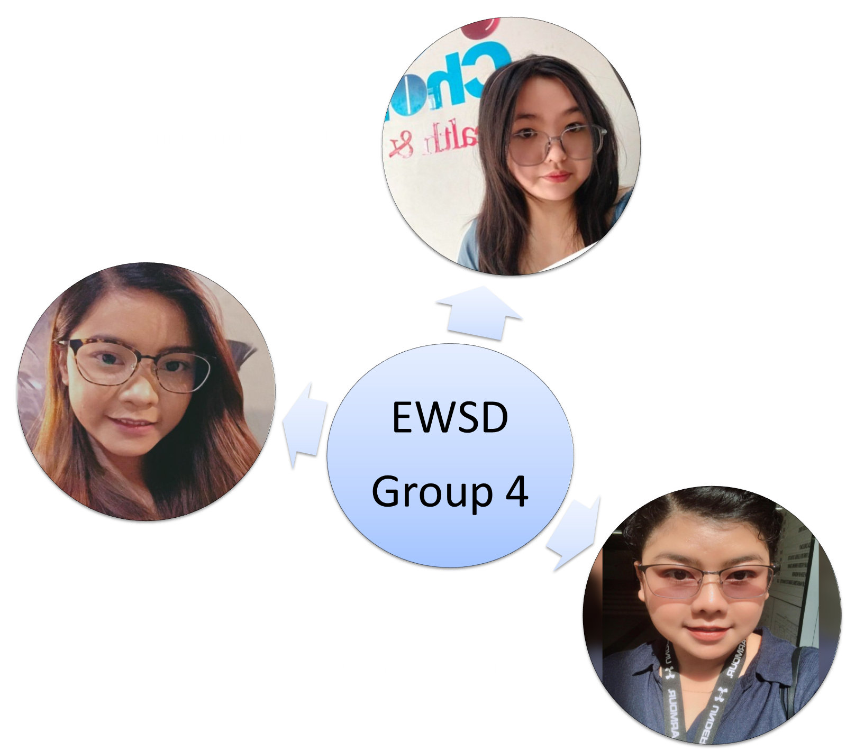
Group : Documentation

Slide 19
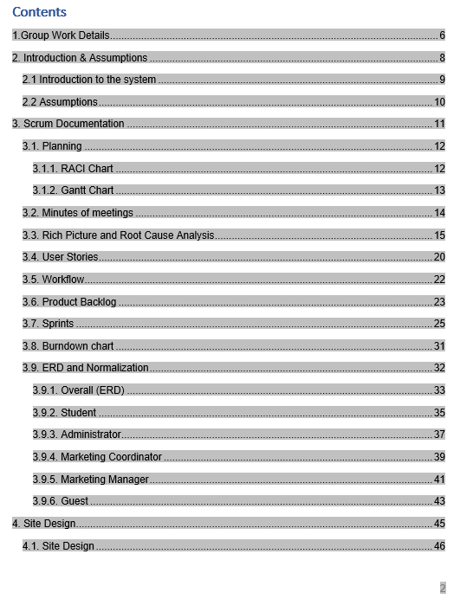
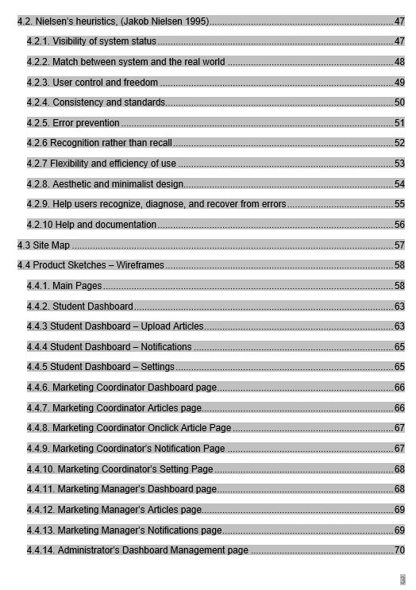
Documentation (Group Report)

Slide 20
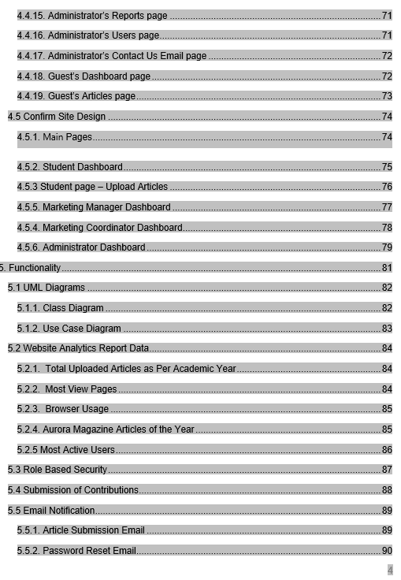
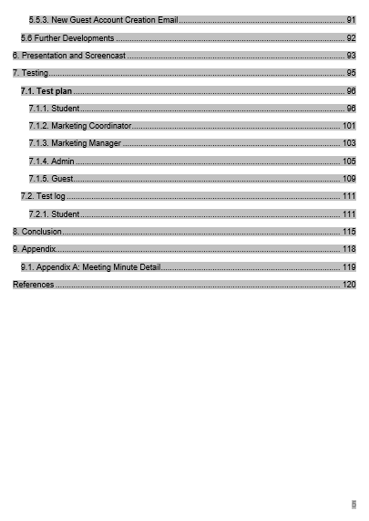
Documentation (Group Report)

Slide 21
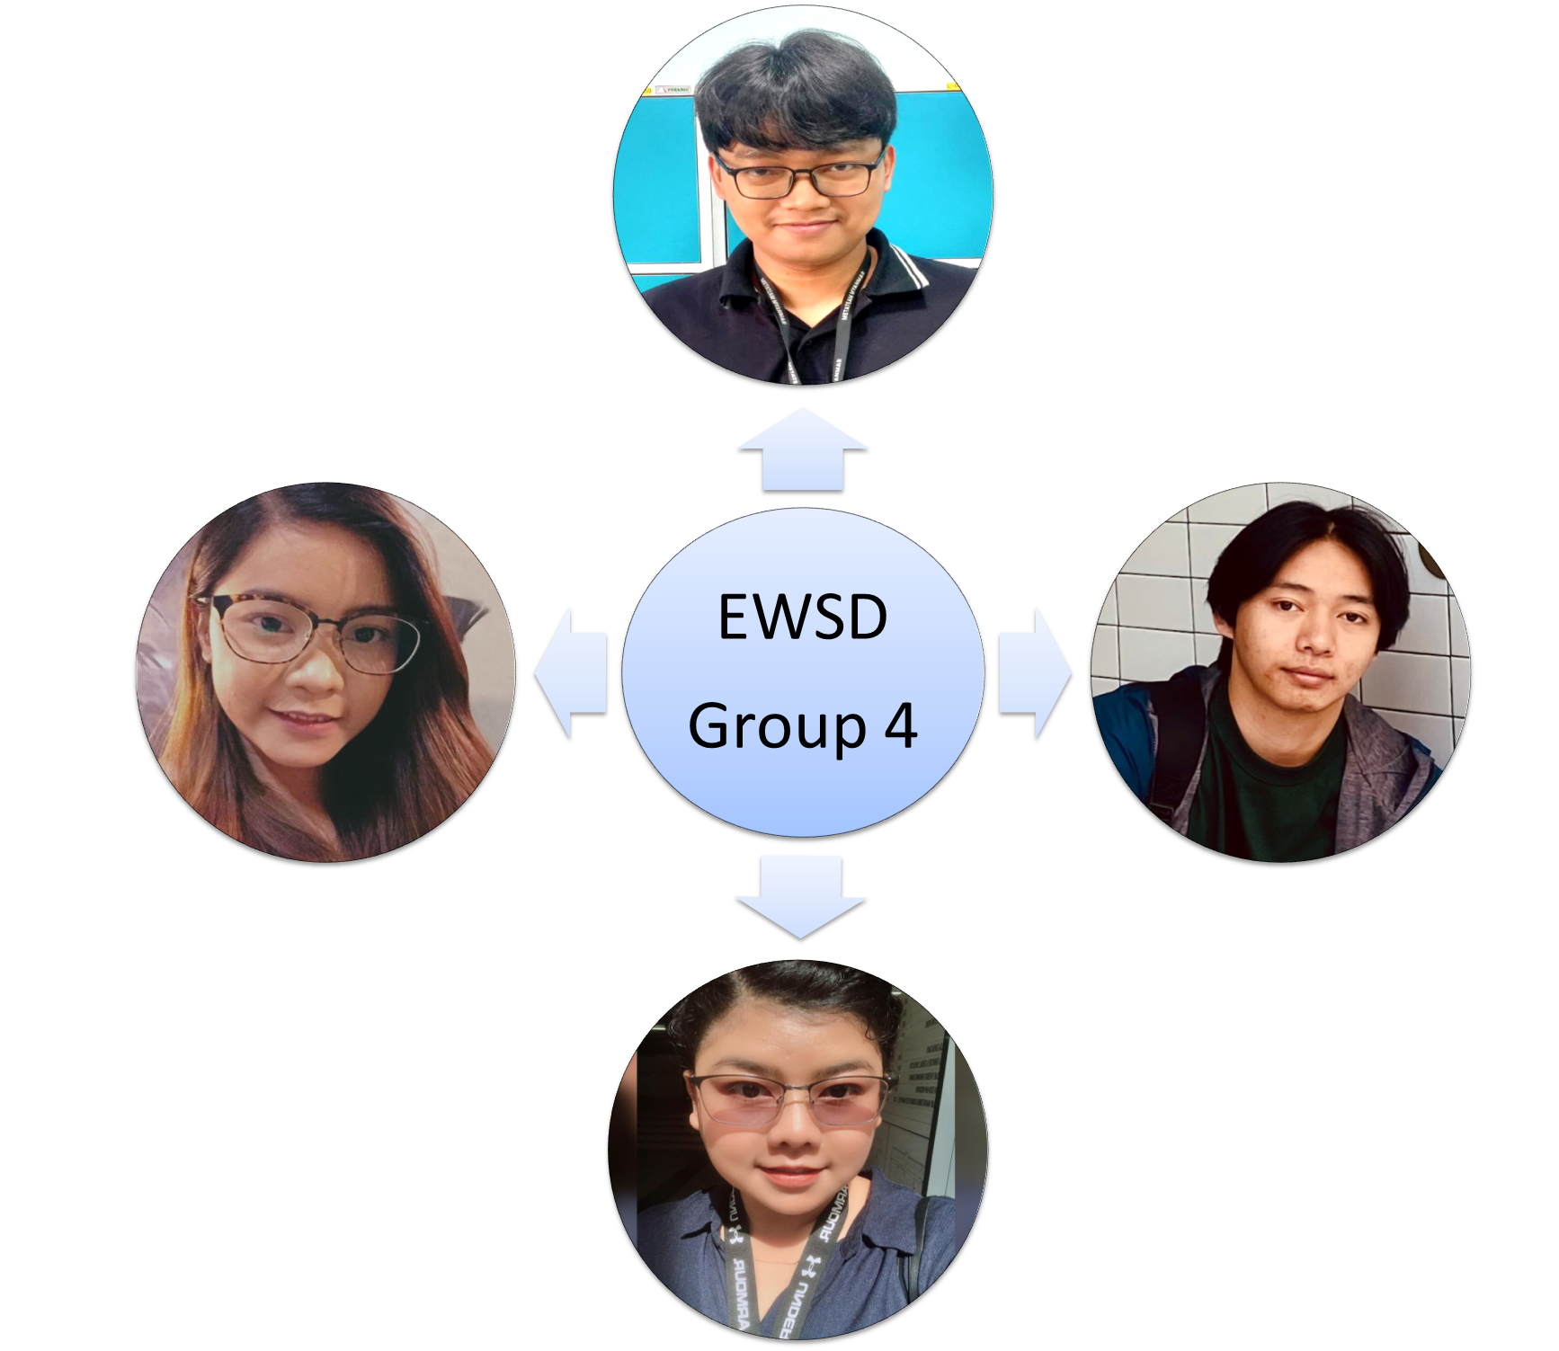
Group : Front End

Slide 22
UI / UX Design

Slide 23
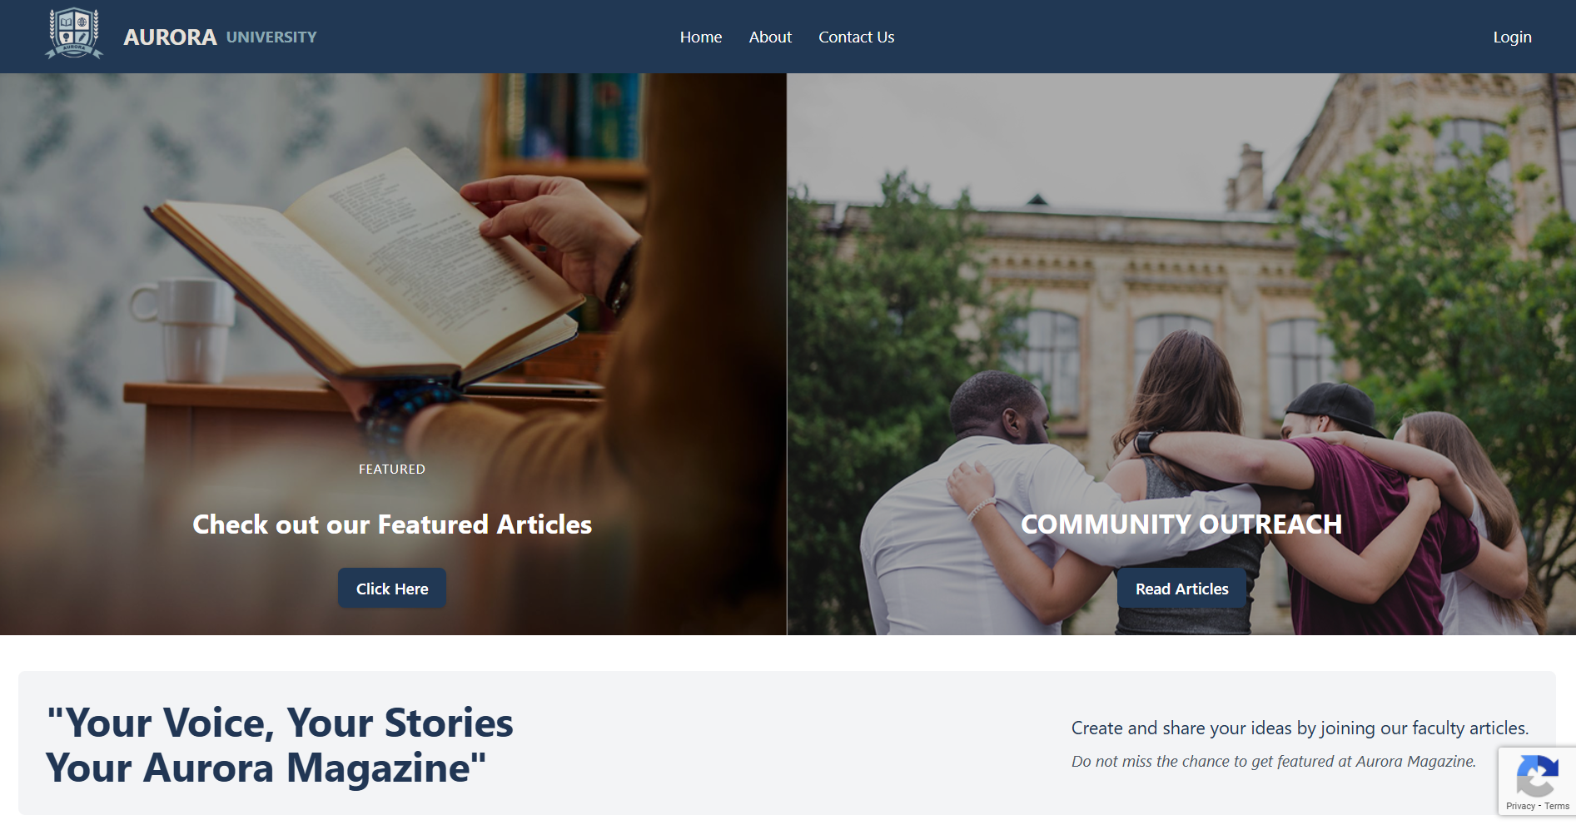
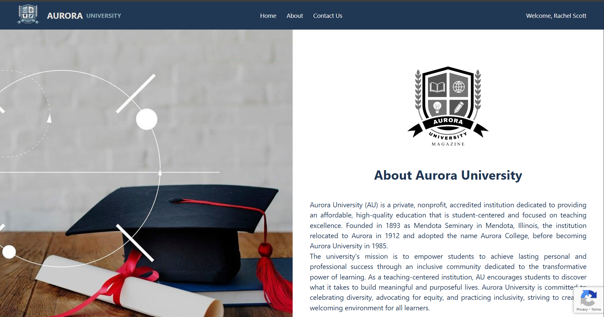
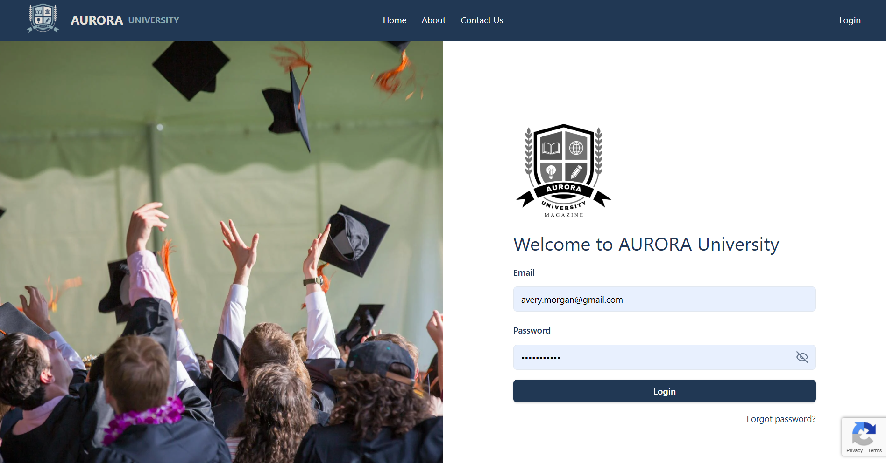
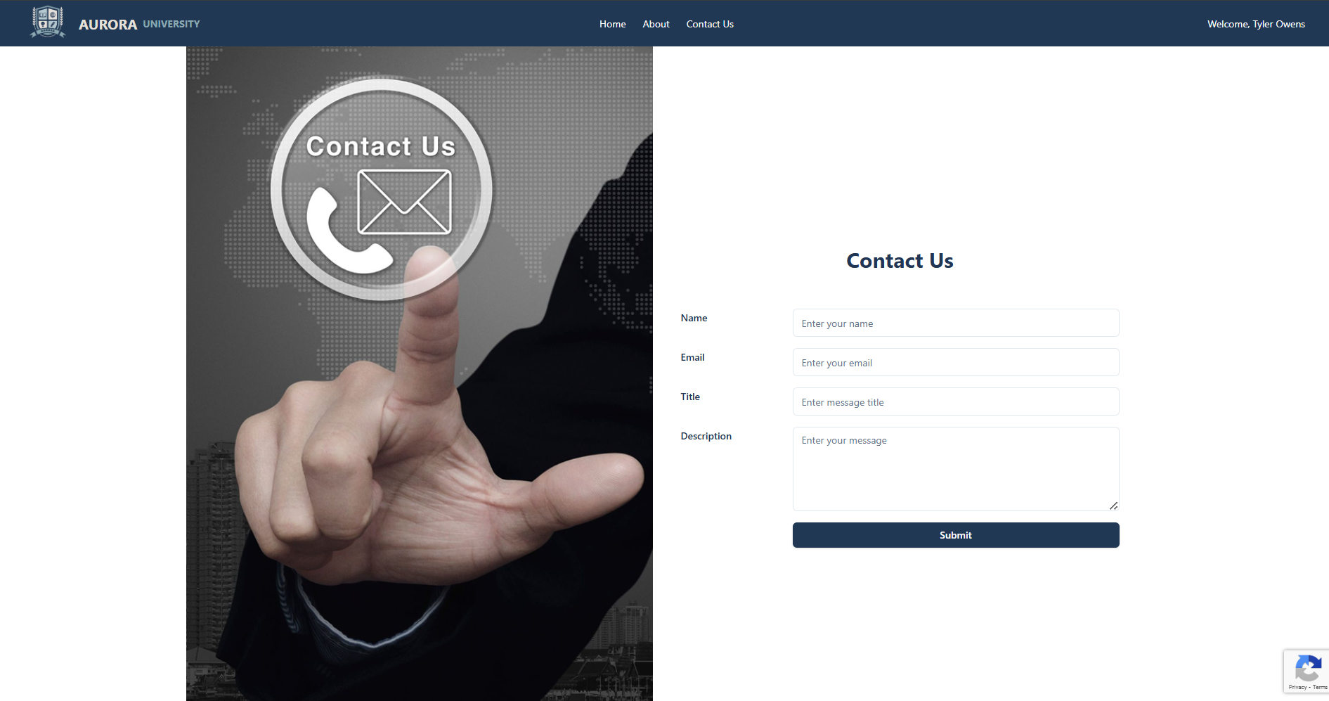
Design Process
Focus on modern design for user-centered and easy navigation.

Slide 24
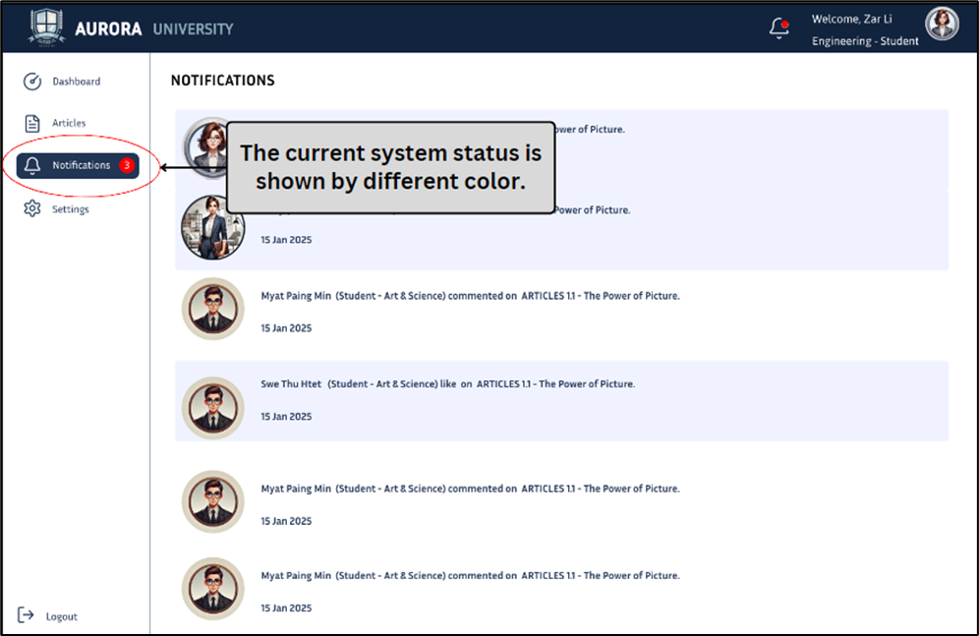
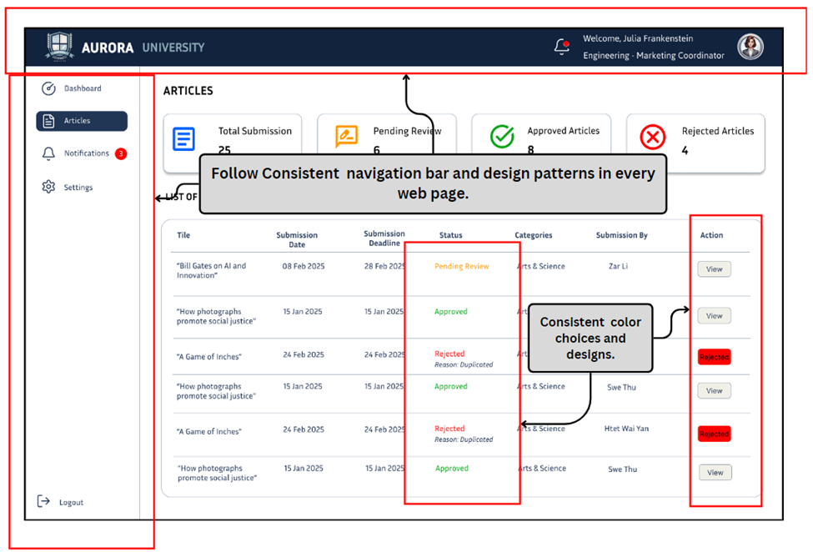
Design Process
Followed Nielsen’s Usability Heuristics (1995)

Slide 25
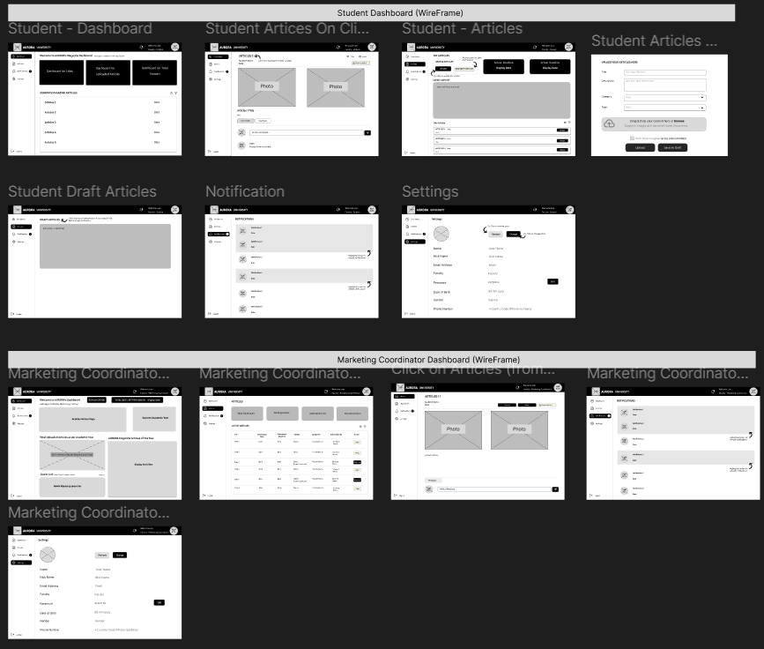
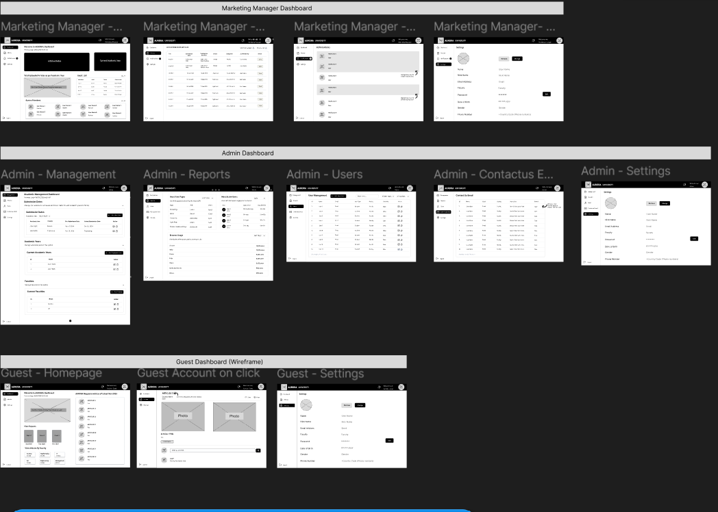
Design Process
Wireframe Examples.

Slide 26
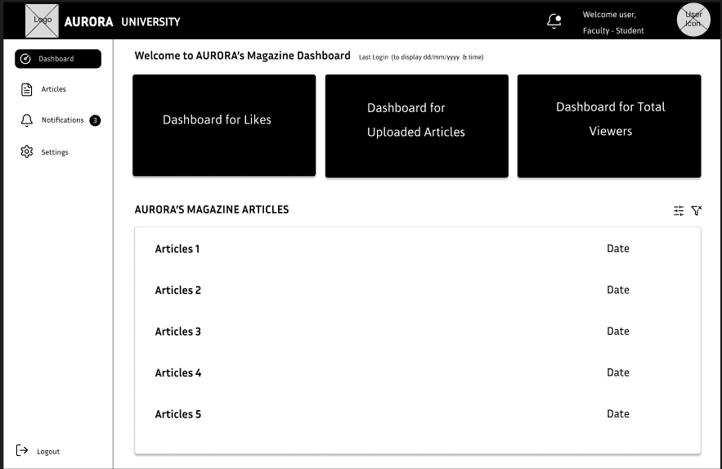
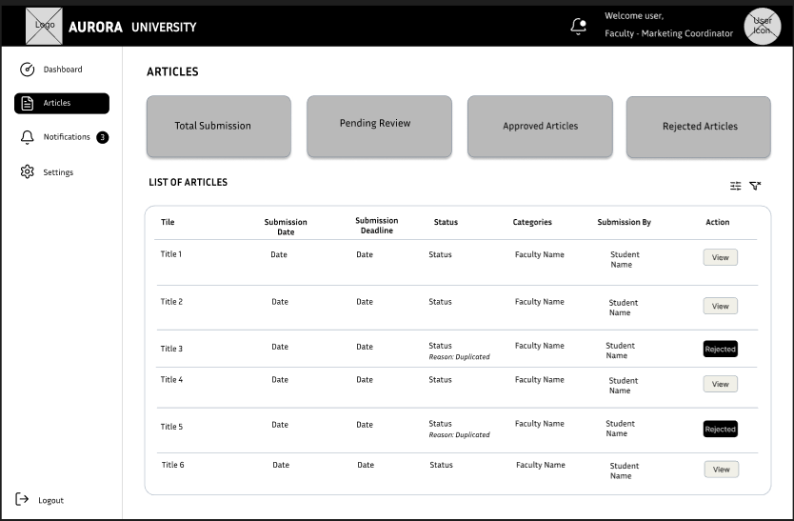
Design Process
Student Dashboard Major Highlight
Coordinator Dashboard Major Highlight

Slide 27
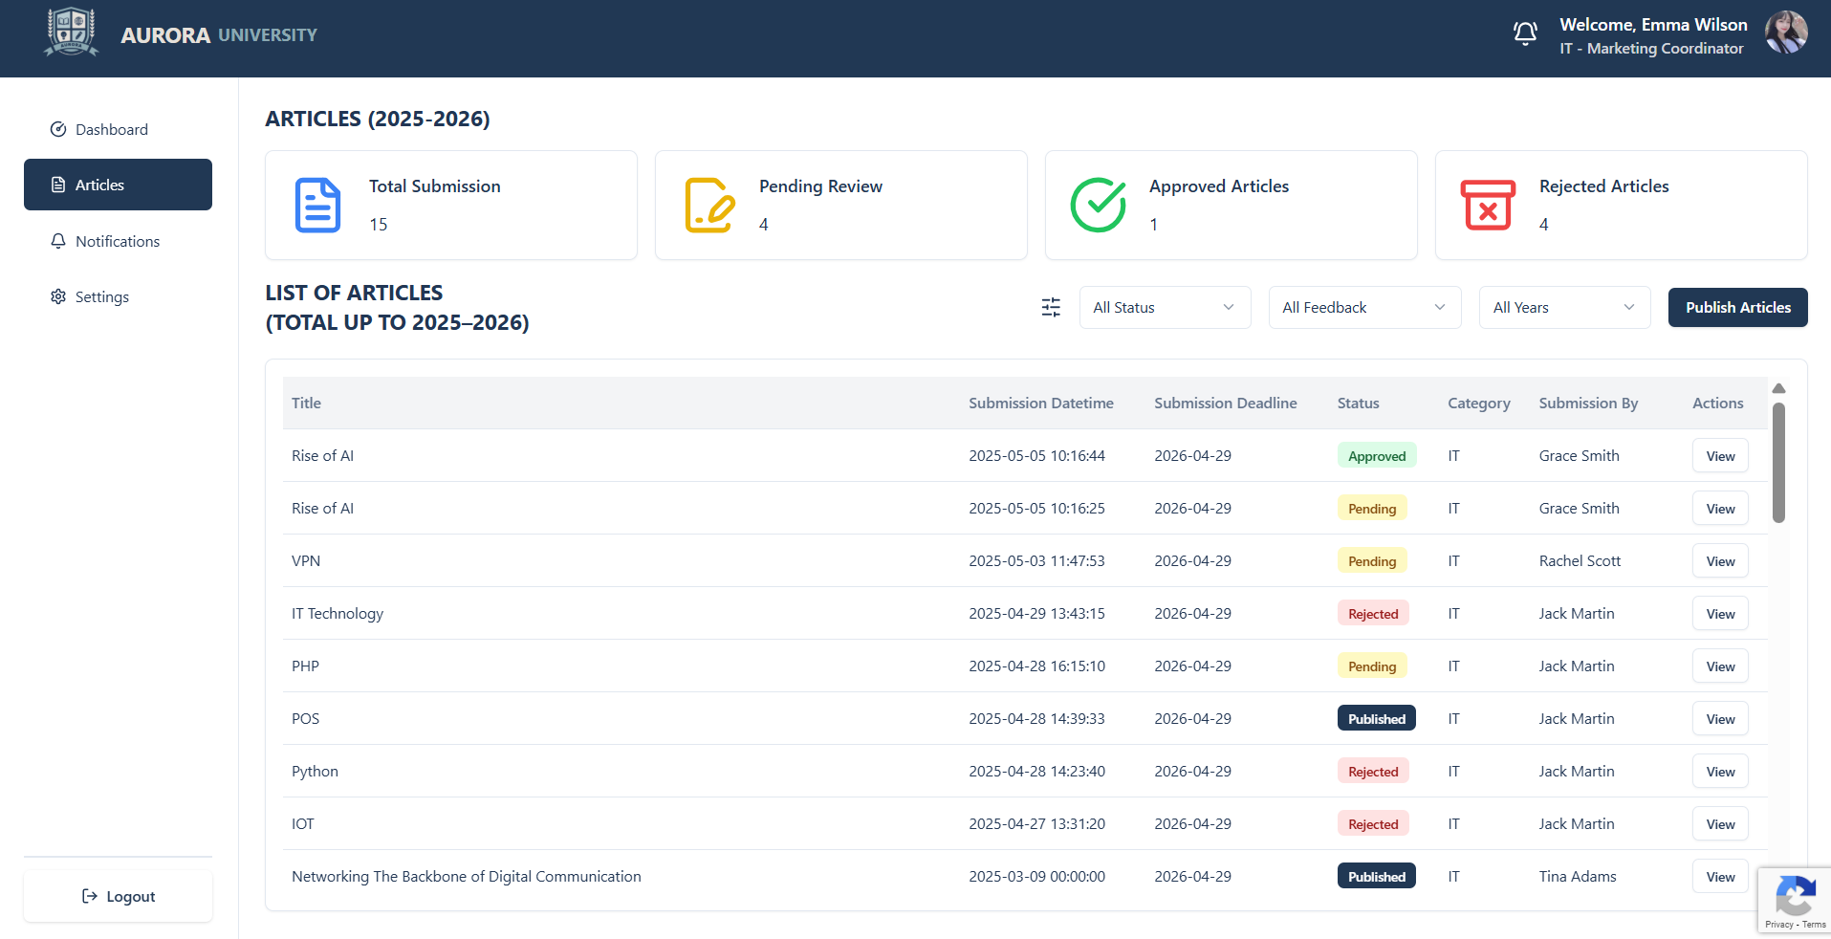



Design Process
intuitive labels and clear color coding

Slide 28



Design Process
89A8B2
Color Pallet #213854 as based color
000000
B3C8C
FFFFFF
E5E1DA
F1F0E8
Major Color Theme and types of Logo

Slide 29
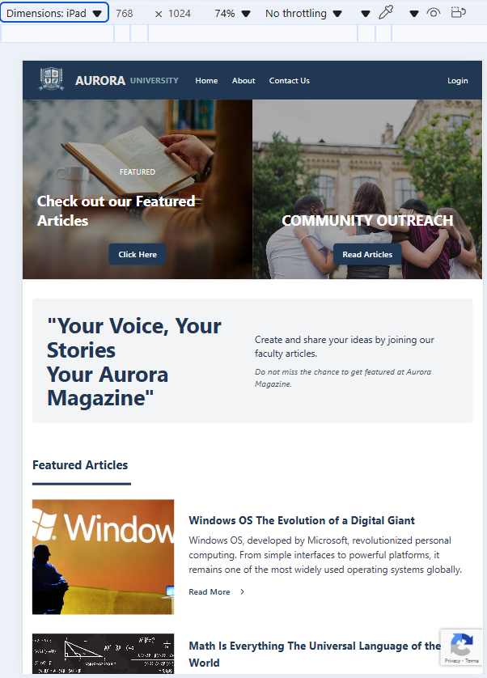
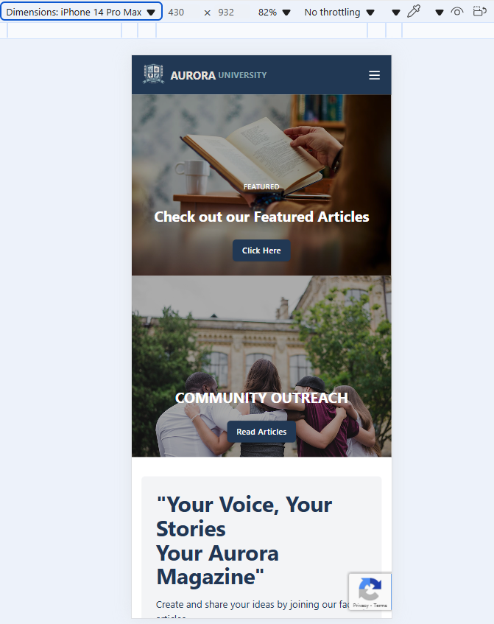
Site Design (Responsive on all devices)
On Phone (iPad)

Slide 30
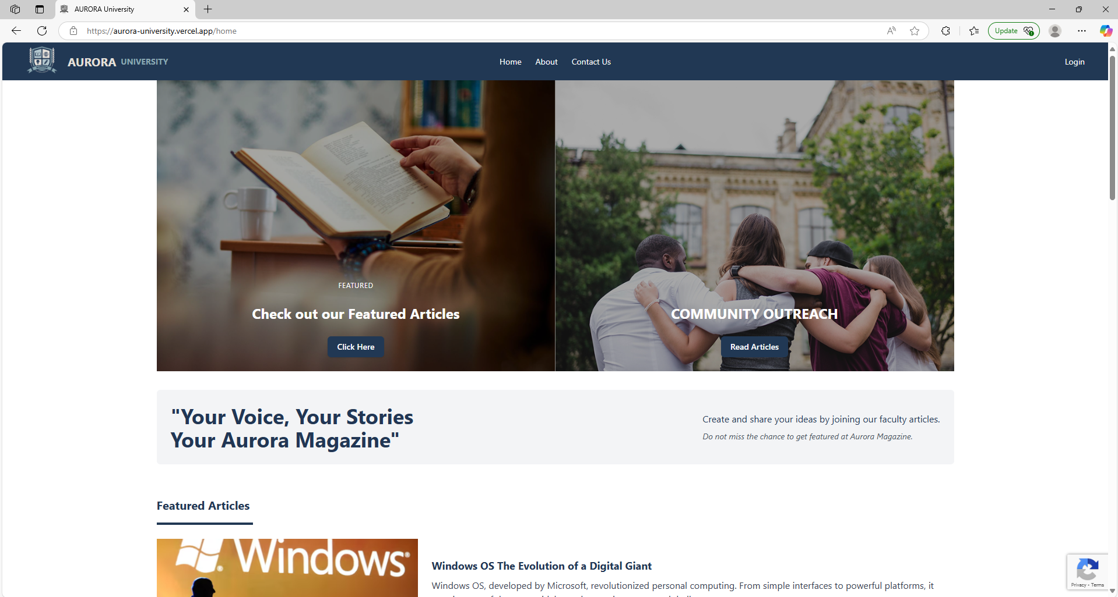
Site Design (Responsive on all devices)
(Laptop Browser : Edge)

Slide 31
Site Design (Responsive on all devices)
Laptop Browser : Google Chrome, Firefox, etc…

Slide 32
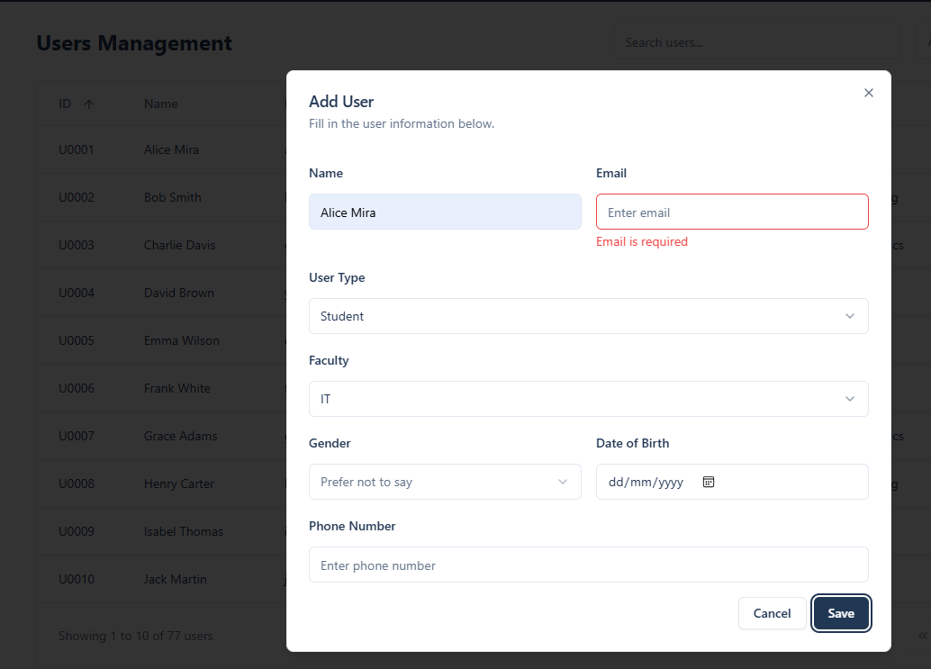
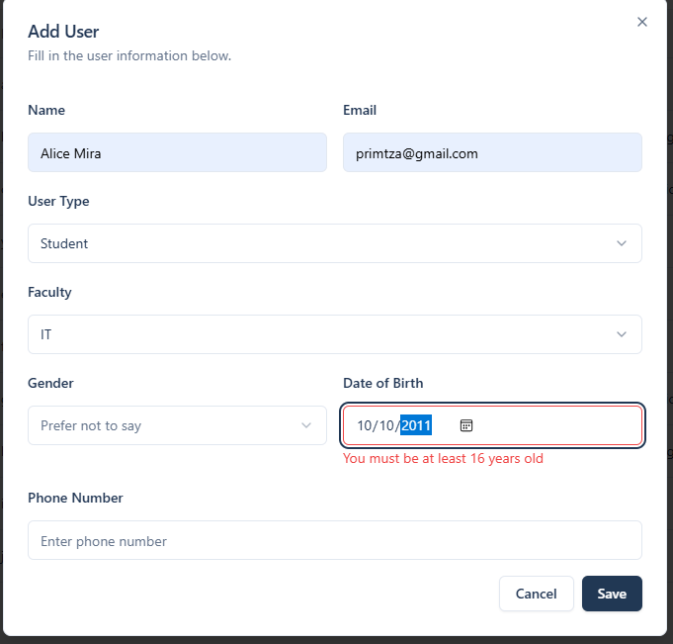
Data Protection from Human Error
Protecting Our System with input wrong information. For keep clean data on report result.

Slide 33
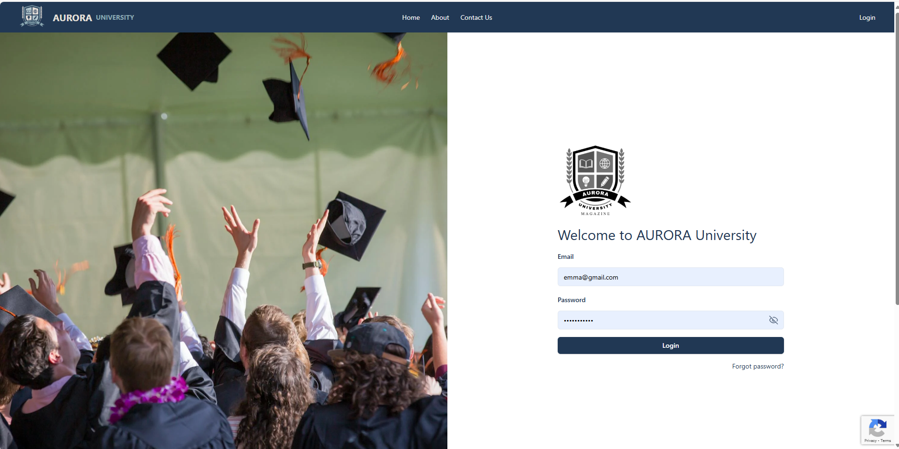
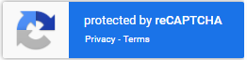
Front End (Program Security)
Protecting Our System with Google reCAPTCHA

Slide 34
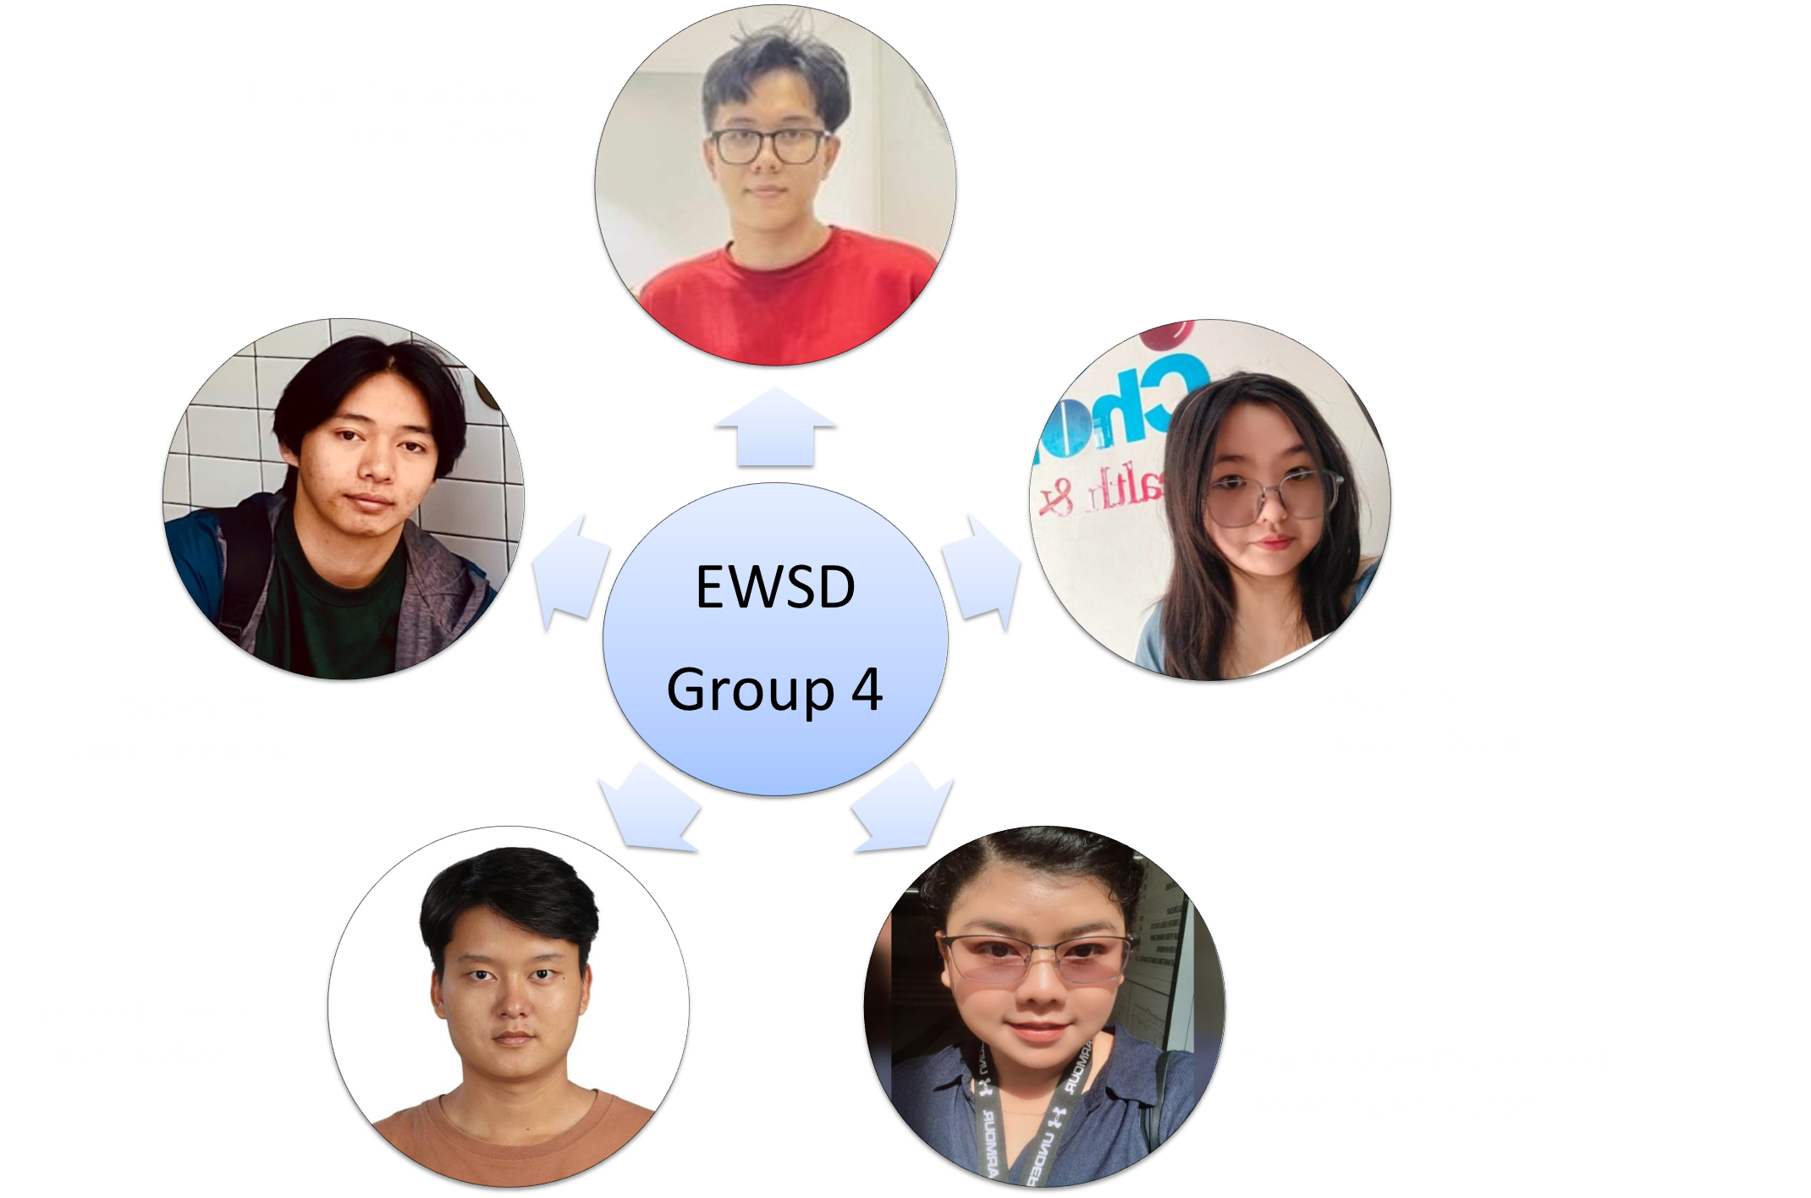
Group : Testing

Slide 35
Feature (Current & Future) : Check list for Comply with Specification
No | Feature | As Requested In Specification | Comply (√/ X)
1 | Secure Role-based Access Control | Different roles: Student, Marketing Coordinator, Marketing Manager, Admin, Guest | √
2 | Article Submission System | Students can submit Word documents (articles) | √
3 | Image Upload Support | Students can upload high-quality images along with articles | √
4 | Terms and Conditions Enforcement | Students must agree to T&Cs before submission | √
5 | Contribution Closure Management | New submissions disabled after closure date; edits allowed until final closure | √
6 | Automated Email Notifications | System emails Coordinators when new contributions are submitted | √
7 | Faculty-specific Contribution Access | Coordinators can only access submissions from their own Faculty | √
8 | Contribution Commenting and Editing | Coordinators can comment on and edit submissions within 14 days | √
9 | Contribution Selection for Publication | Coordinators can select articles for publication | √
10 | Centralized Viewing for Marketing Manager | Manager can view all selected articles but cannot edit | √
11 | Bulk Download of Selected Articles | Manager can download all selected contributions as a ZIP after final closure | √
12 | System Administration Tools | Admin can manage system settings, closure dates, user accounts | √
13 | Guest Viewing Access | Guests can view selected contributions by Faculty | √
14 | Statistical Reporting and Analysis | View reports like number of contributions per Faculty | √
15 | Responsive User Interface | System interface adapts to mobile phones, tablets, and desktops | √

Slide 36
Feature (Current & Future) : Check list for Comply with Specification
No | Feature | As Requested In Specificaiton (Additional Features List) | Comply (√/ X)
1 | Last Login Reminder / First Login Welcome | Display the user's last login date/time or welcome message if first login | √
2 | System Usage Monitoring Reports | Admin can view reports about:
 |  | - Most viewed pages | √
 |  | - Most active users | √
 |  | - Browser usage statistics | √
3 | Guest Registration Notification | When a guest account is created, the system sends an email to the Faculty's Marketing Coordinator | √
4 | Guest List Viewing for Coordinators | Marketing Coordinators can view a list of guests registered under their Faculty | √

Slide 37
Feature (Current & Future) : Additional Feature
No | Feature | Additional (Not request in specification)
1 | Faculty-specific Article Management | Manager can download individual articles as word file.
2 | User Management, Analytics Dashboard | Receive contact-us message from contact-us page user message.
3 | System Settings Management | Admin can reset passwords upon user request.
4 | Commenting, Feedback System and Real-Time Notification | Students and guests can comment and react to articles.
5 | Profile Management | All users can update their personal profiles. (with the restriction as user and admin can view)
6 | Social Media Integration | Integrate the magazine system with platforms like Facebook, Instagram, and LinkedIn. This will boost visibility for students’ works and increase university outreach
7 | Highlight Top Articles on University’s Official Website | best-rated or most-read articles can showcase the talents of Aurora’s students and attract prospective students and partners

Slide 38
Structured Testing: Test Plan & Test Logs
Test Plan:
Scope, objectives, and test logs.
Resources (tools/environments).
Timeline and responsibilities.
Test Log:
Records executed test logs.
Pass/fail results.
Documents defects and steps to reproduce.

Slide 39
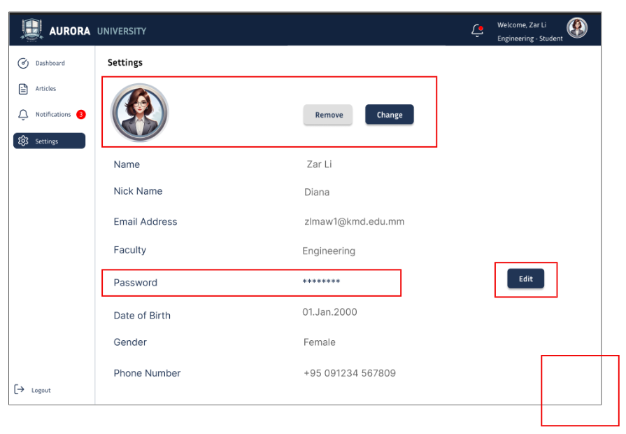
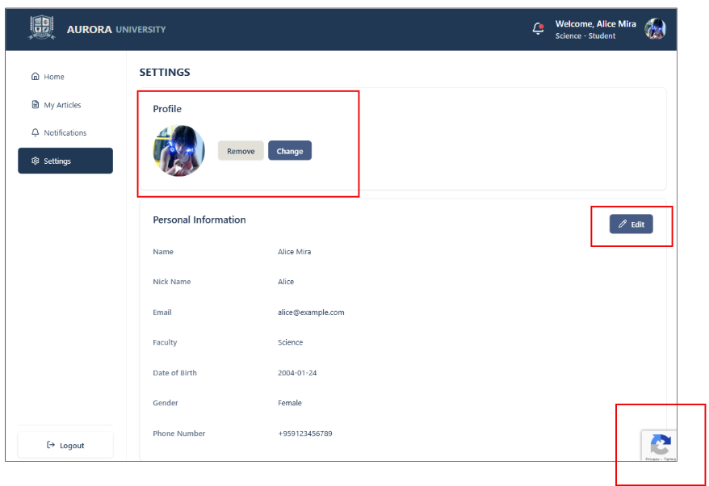
Improvements Through Iterations
Before Iterations:
After Iterations:

Slide 40
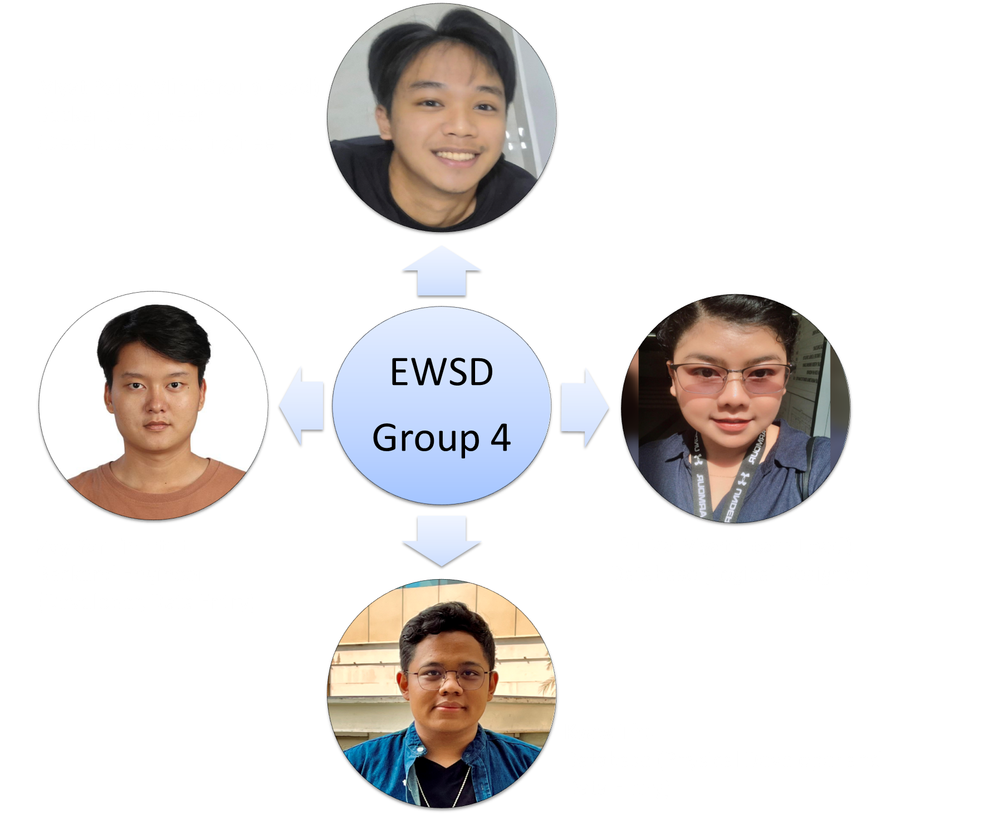
Group : Back End and Database

Slide 41
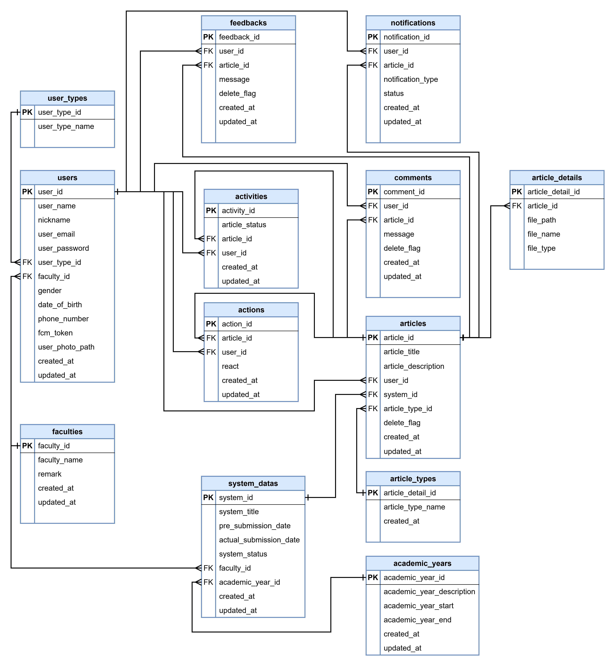
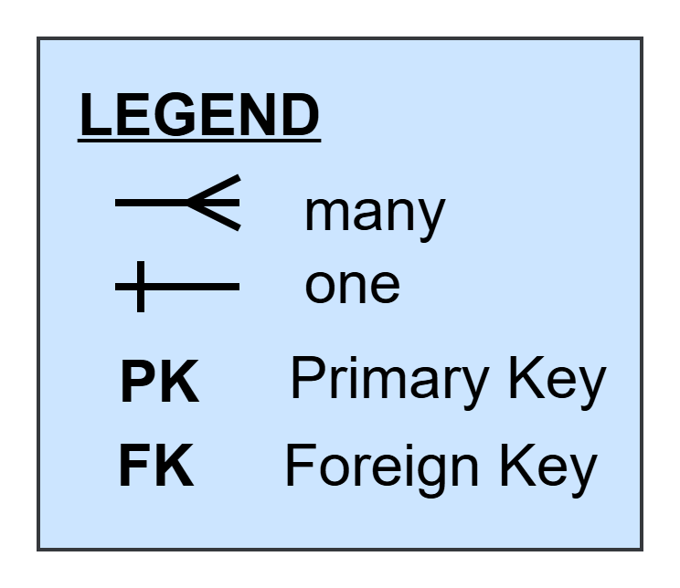
Database (Logical)
. . . . .
Overall ERD Daigram

Slide 42
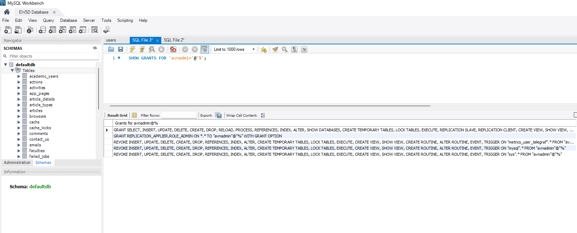
Database (Physical : System Access)

Slide 43
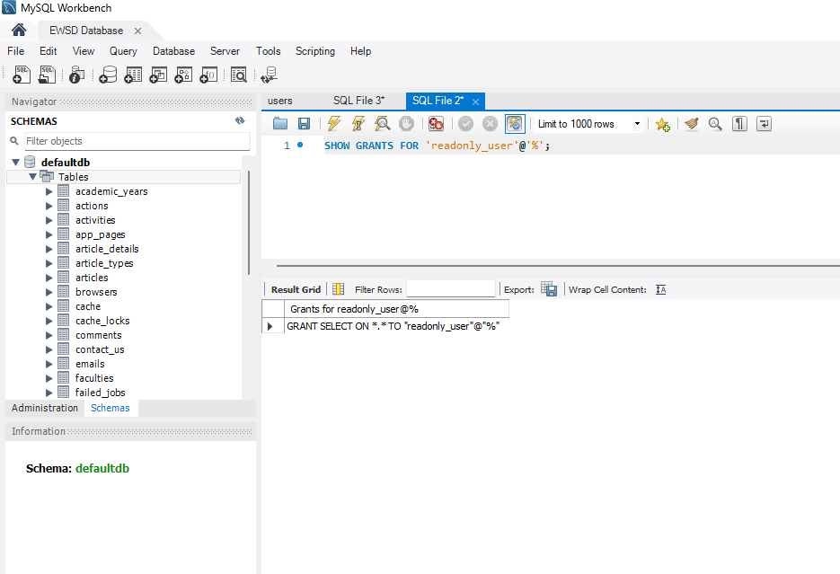
Database (Physical : System Access)
. . . . .

Slide 44
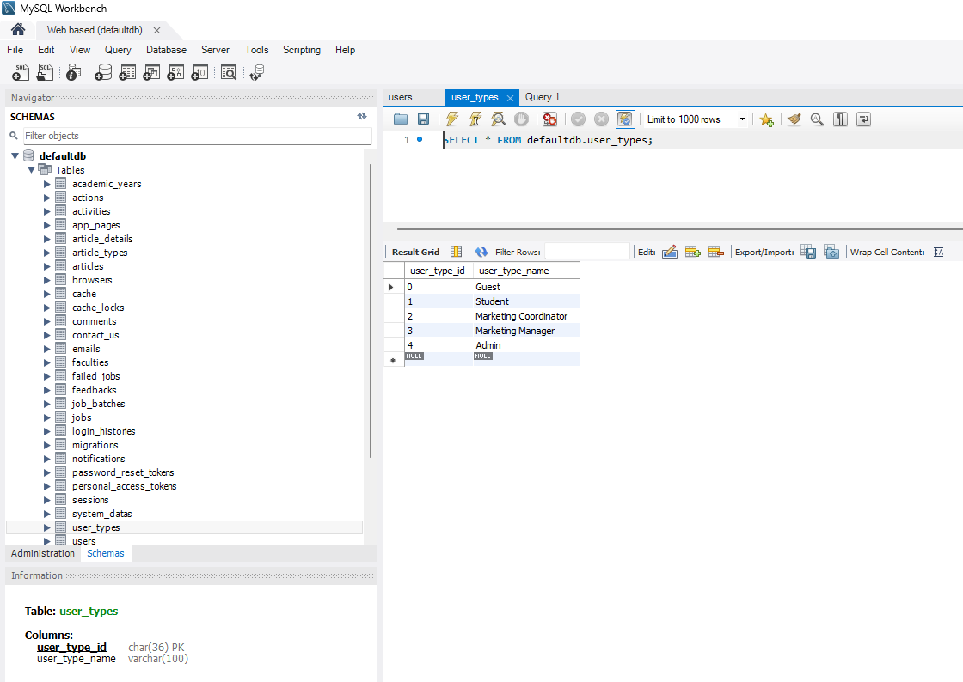
Database (Physical : Secure role access)
. . . . .

Slide 45
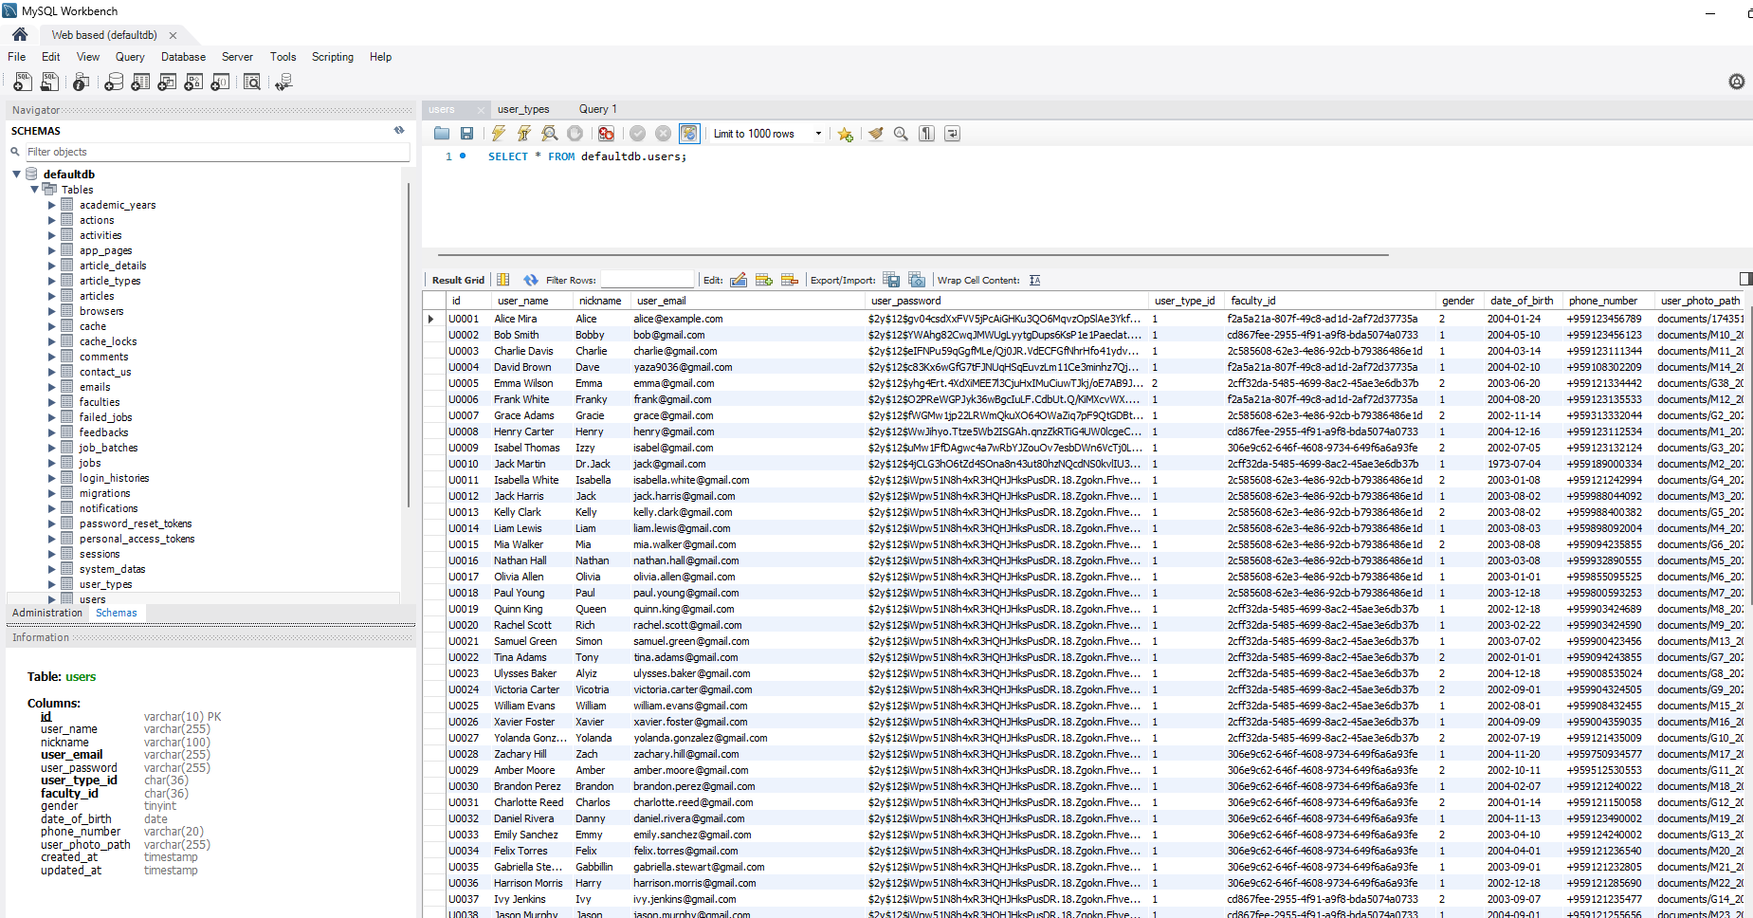
Database (Physical : Hatching for ID and password)
. . . . .

Slide 46
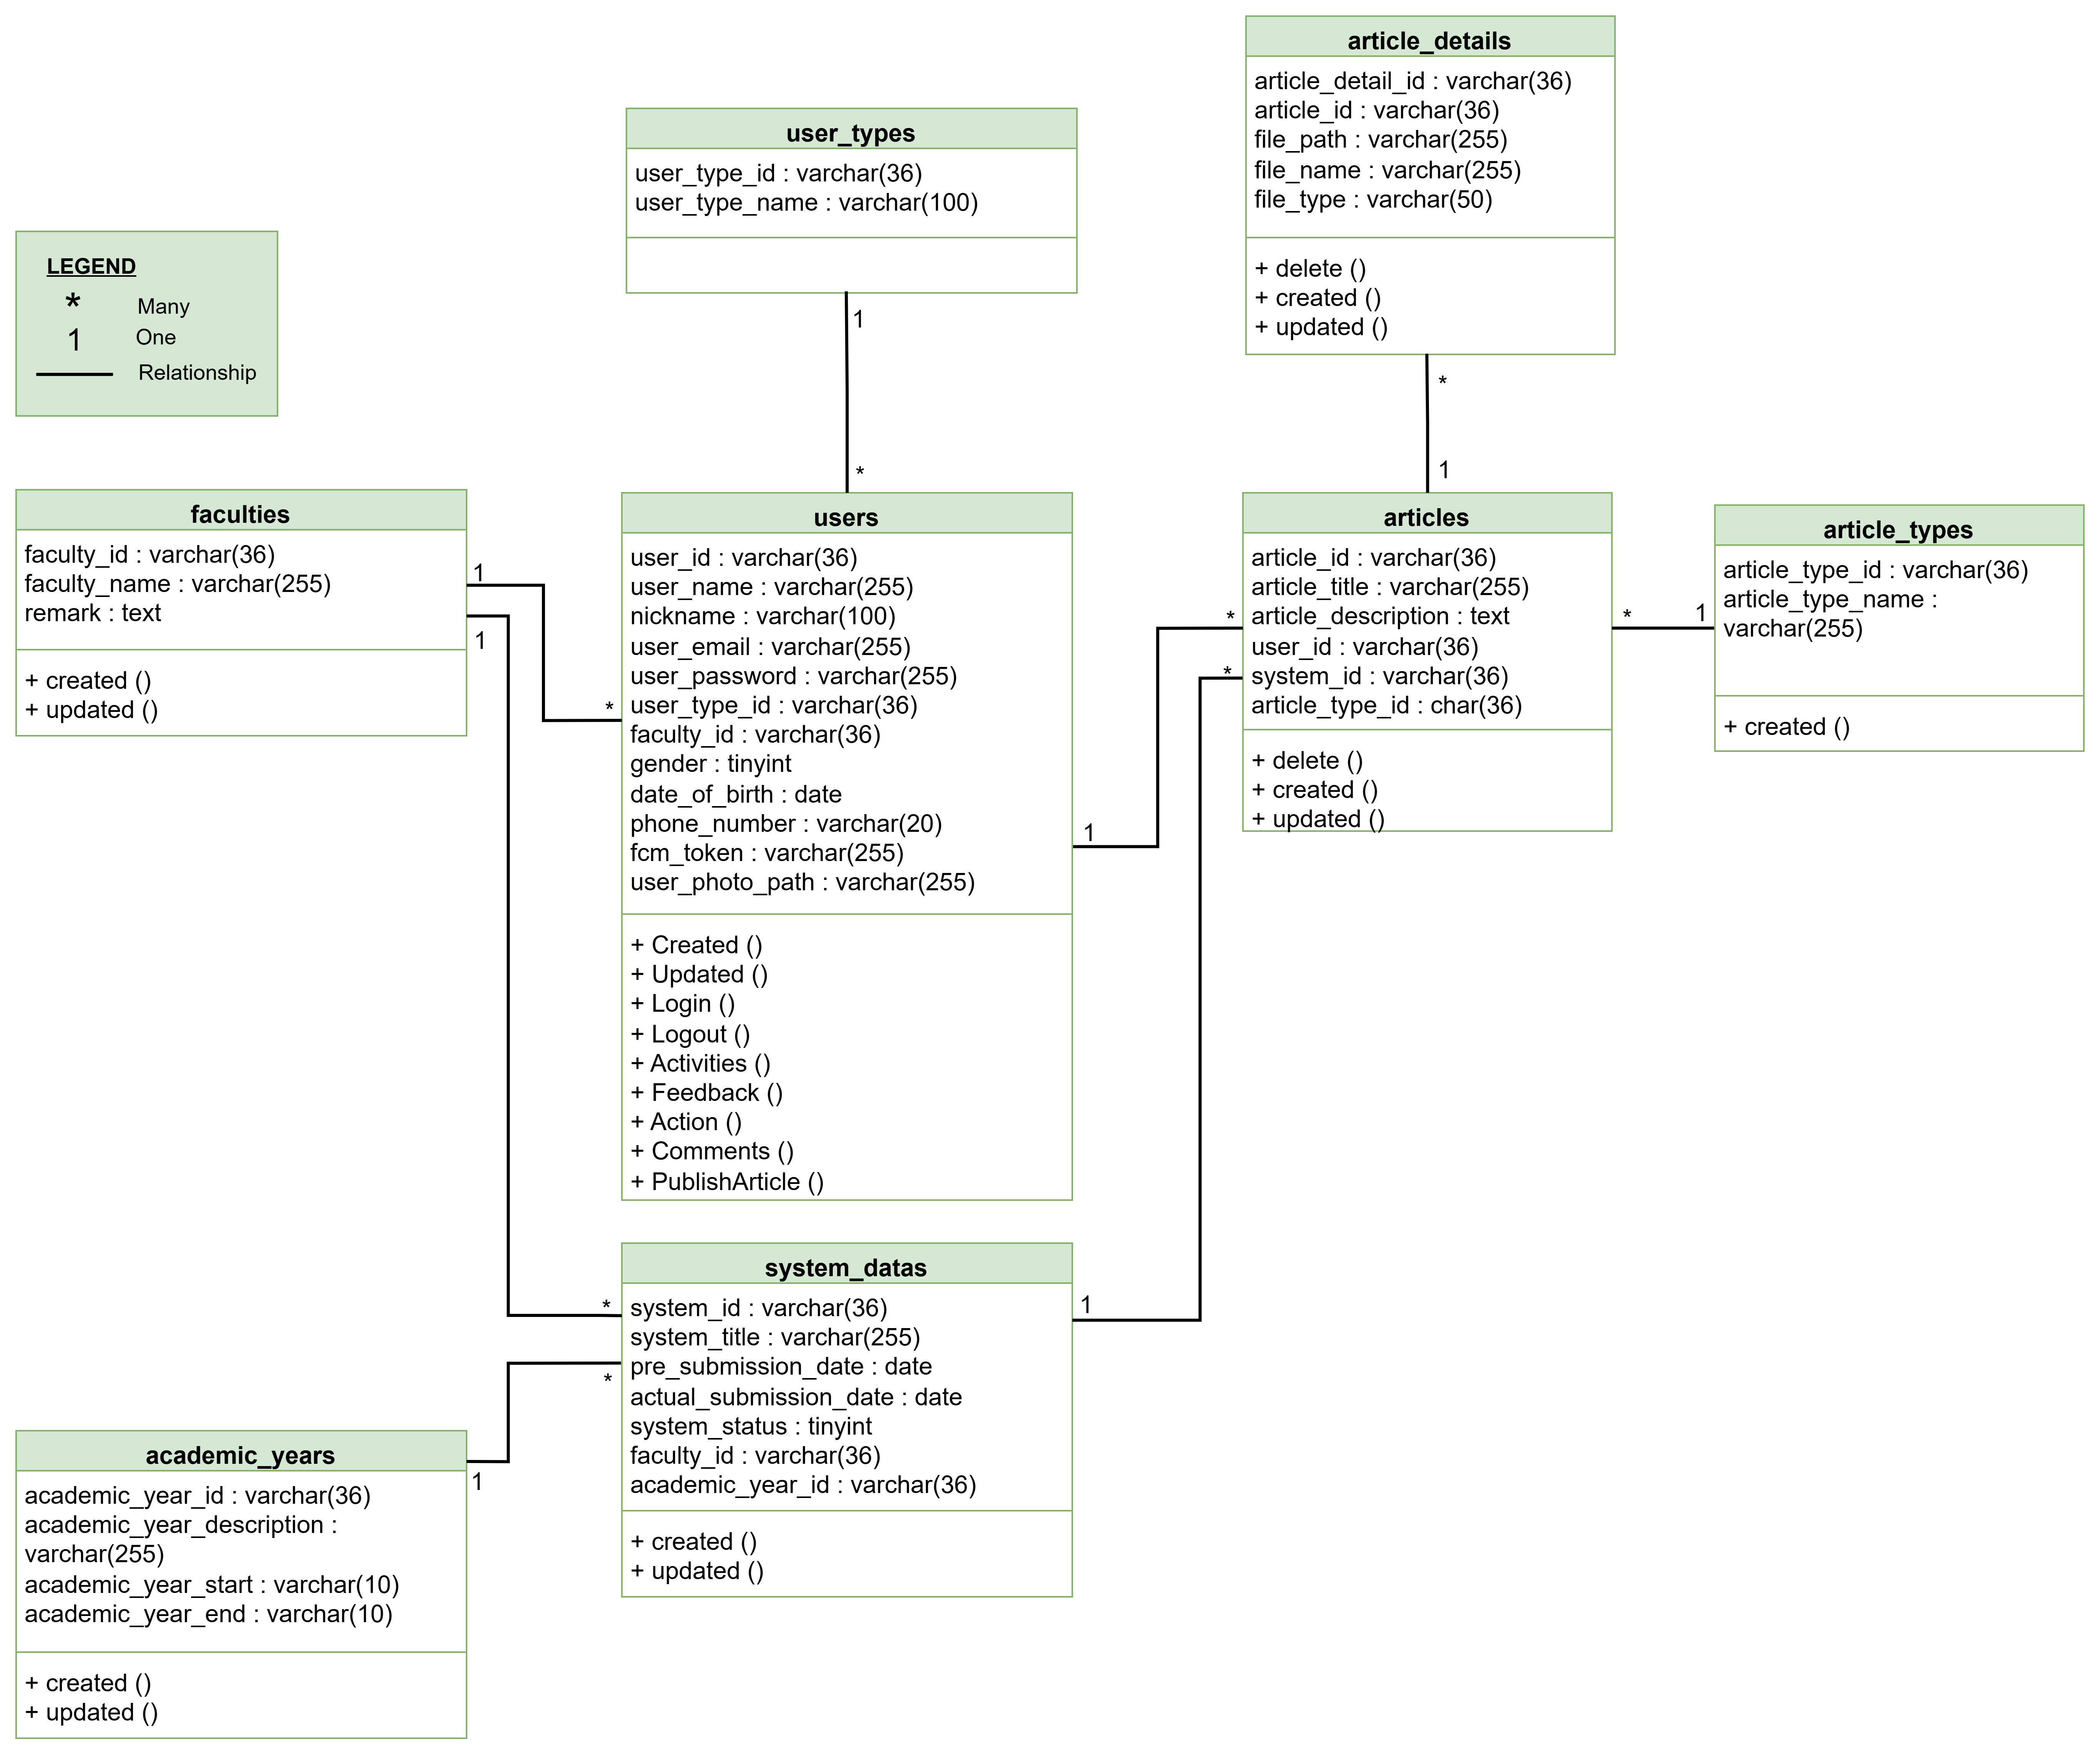
Overall Class Diagram
. . . . .

Slide 47
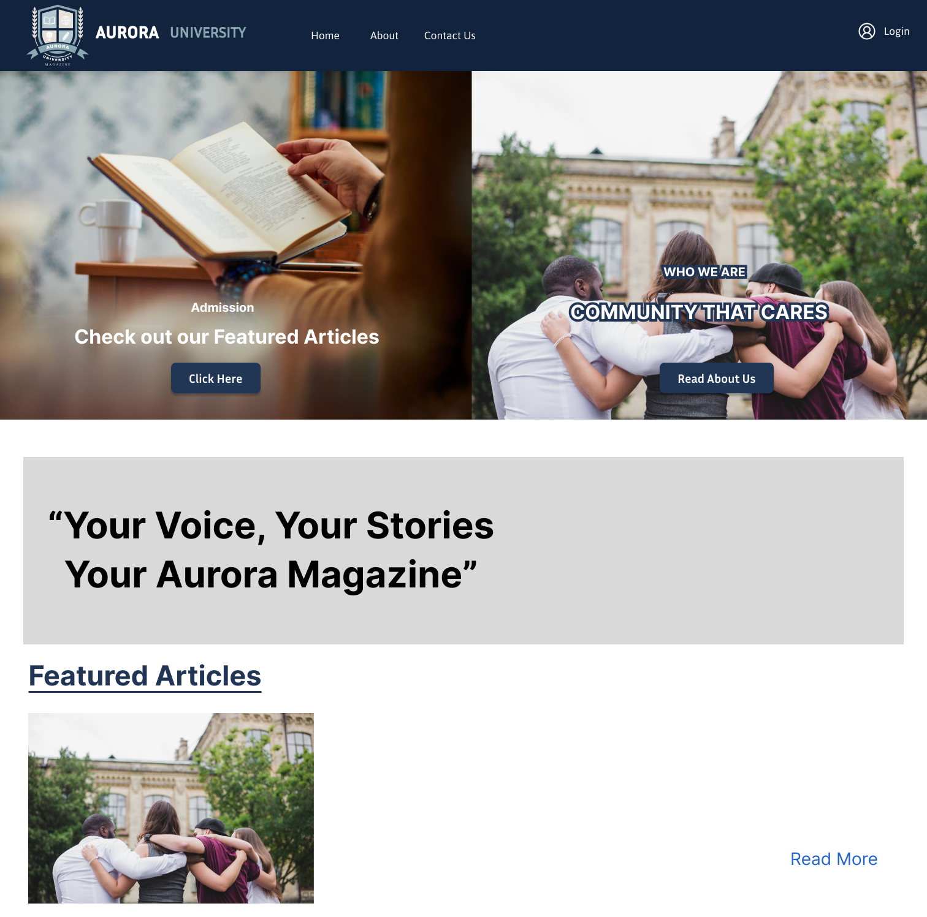


Project Runtime (Demo)
Now, some quick highlights of the system,
including:
Logging in as different user roles
Submitting and managing articles
Publishing articles and viewing reports.
https://aurora-university.vercel.app/home

Slide 48
Article Status
• Draft
• Pending
• Approve
• Reject
• Published

Slide 49
Notification (By System For Articles)
Student
React
Commnet
Coordinator
Create
Manager
Publish
Feedback
Update

Slide 50
Mail sending conditions
Relevent User
(for All User Type)
Account Creation
Coordinator
Guest Account Creation
Article Creation
Password Reset

Slide 51

Q & A Section

Slide 52


